Slide 1

Journey Towards Proactive Operations
Sep 2021
Notes:
This is the PowerPoint version of the book https://www.VMwareOpsGuide.com/
The website eventually will cover more than the book as the book is not a product book. It does not cover vRealize Suite feature by feature. It is not a place where you learn the product.

Slide 2
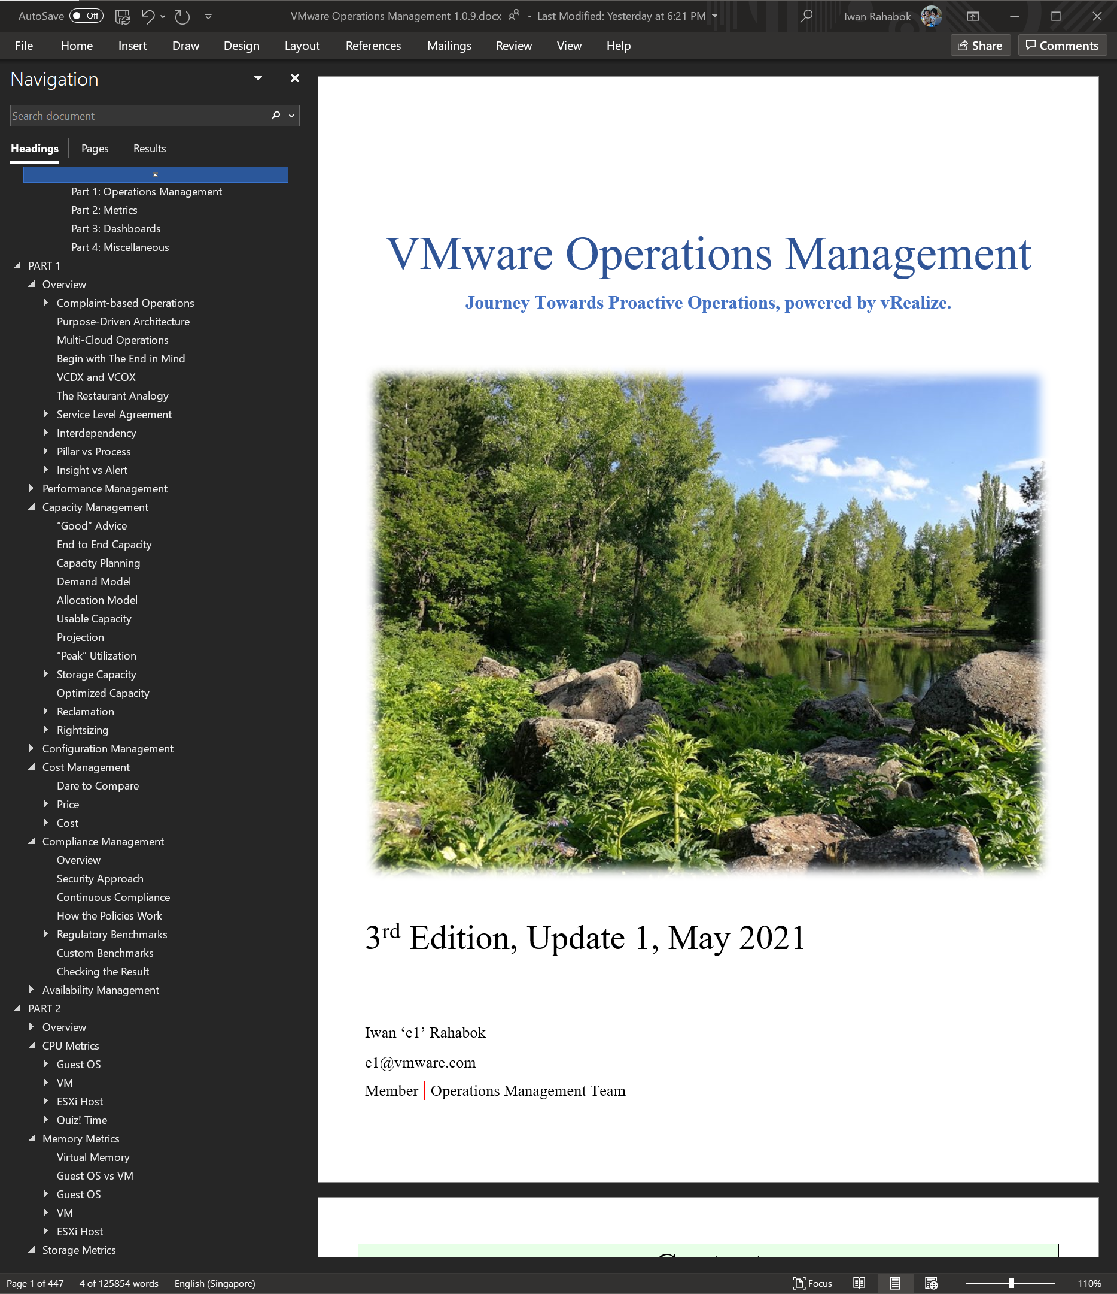
Book vs Workshop
The Book
The Workshop
Focus on the Operations, the process.
Focus on the Architect, the individual.
In-depth Reading
Peer Sharing and small group discussion.
Hands-on. Access your vR Ops and Log Insight as you read along
Not a hands-on session. Live demo by Facilitator, and sharing by attendee.
Complete coverage of operations
Only performance and capacity management, and focus on more pressing components
~1 week period in multiple reads & apply
3 hours in 1 session
The Workshop is based on the book. To keep it within 2 hours, it takes a small subset of the book. The original workshop ran for 2 days.
It’s designed for workshop-style delivery with active discussion. Not designed for large scale, one way lecture.
Designed for Infrastructure Architect, not other roles. The book covers all roles.
Notes:
Note: the book gets a monthly update. Picture shown is earlier version.
The deck is designed for audience participation. For example, get an audience to explain, as the texts are all there in the slide actually.

Slide 3

First Thing First: You
About Your Speaker and About You
About You
Name, Company, Industry
Experience: VMware and non VMware
The environment you manage
Size: physical, virtual, team
Complexity: Process, People
Operational challenges you face
Availability
Performance
Capacity
Compliance
Configuration
Cost
This Photo by Unknown Author is licensed under CC BY-NC-ND
Notes:
Point of this slide: Learning from fellow workshop attendee is critical to the success of the workshop.

Slide 4
The Rise and Fall of Infrastructure Architect
First Thing First: You.
Impact on your work
Impact on you
Relevance to Business
X86
Commodity
Business Architect
Service Architect
Systems Architect
Virtualization
Services
Cloud
Utility
Bespoke
Standardized
Infra Architect needs to move up from “techie”. IaaS, not SDDC.
Notes:
Key point: architecture is becoming a given, so move up as that’s where your career needs to go.
Commodity: it initially hit servers, and now it’s hitting storage too. Dedicated storage arrays are literally disappearing, being replaced with converged infrastructure. Storage Admin job is going down with the arrays. Part of network is also being virtualized.
Reference in the book:
Part 1 Chapter 1 “Overview” chapter, especially VCDX and VCOX section.
Part 4 Chapter 9 “Infrastructure Architect” chapter for background and personal sharing. We all have our story story

Slide 5



Your World. Not operationalized.
How it started
Your Customers
Your Boss
“Need more HW! Your infra is slow”
“Your infra is not full. Add more VM!”
You
Notes:
We creates the Operationalize Your World because we see a lot of VMware Admin/Engineer/Architect struggle. They are squeezed in between their customers and their boss.
Customers demanding better service, faster performance, higher uptime, fewer disruption.
CIO demanding less budget.
You.
You are a pro. You can architect a solid enterprise-grade global infrastructure. So why are you squeezed in between? This is something we want to solve.
If you need to know the answer right now, the short answer is because your Customers and your Boss aren’t measuring the same thing. You need to align them.
Reference in the book:
Complaint-based Operations, located in Chapter 1 of Part 1.
VCDX and VCDX, located in Chapter 1 of Part 1.
Interdependancy, located in Chapter 1 in Part 1
----------------------------
On the lighter side, do you recognize 2 of the photos?
Your Boss. That’s Ajay, my former big boss and advocate of Ops ☺
You. That’s Karen, head of R&D for vR Ops team in Armenia. Armenia is the home of vR Ops. I’ve been privileged to spend a total of 9 weeks to date in the last several years.
You can find Karen at https://www.linkedin.com/in/karenaghajanyan/

Slide 6



Unifying the Consumer & Provider Layers
You get what you paid for
Performance
Price
Notes:
And the reason why their demand doesn’t connect well is because they are looking at different things. So you need to unify them. Design the same model for both entities. Same operational models, else you are caught in between.
Reference in the book:
Begin with The End in Mind, located in Chapter 1 in Part 1
The Restaurant Analogy, located in Chapter 1 in Part 1
Service Level Agreement, located in Chapter 1 in Part 1

Slide 7
Where to Measure IaaS Performance
IaaS performance, not VM performance
VM
VM
VM
Guest OS
Guest Contention
Guest Performance
VM Utilisation
VM Capacity
VM Contention
IaaS Performance
ESXi + physical infrastructure
Performance SLA
IaaS Utilisation
IaaS Capacity
Notes:
Now that we have redefined IaaS performance, where exactly do we measure it?
First of all, do not confuse “metric types” with “pillars of operations”. Contention and Utilization are metric kinds. They are just inputs to what you actually manage. Take an example
Utilization is the metric. Capacity is the discipline. In IT operations management, there are many disciplines, such as Capacity, Performance, Configuration.
Each areas are measured using metrics. A metrics belong to a type, such as utilization and contention.
Next, know the difference among the layers. There are 4 layers, each focuses on different answers.
The 1st level is the Guest OS contention. This is beyond the control of the IaaS. It’s completely up to Guest OS to manage their given resources. vR Ops provides unique ability to peer deep into it.
The 2nd level is useful for tracking the VM capacity. Say a VM is given 8 vCPU. If you want to know if it’s using it, this is the area where you measure it. Whether you measure it In-Guest or VM level, it depends on the specific use case because each layer lacks visibility into the other.
The 3rd level is where the VM meets the Infra. This is where you track if Infra is serving the VM. The good thing is vSphere actually tracks if it’s unable to serve a VM. It tracks, for each and every VM, if the VM does not get what it asks.
The 4th level is the underlying IaaS. This level is irrelevant to the VM Owner. This is normally the domain of Capacity Planner
Reference in the book:
Part 1 Chapter 2 Performance Management: Contention vs Utilization

Slide 8
What you measure vs what you manage
You can’t manage what you cannot measure
Metric Types
Operations Management
Business Application
Business metrics
Performance & Capacity
VM
VM
App Contention
App Performance
Guest OS
Container
Service
App Utilization
App Capacity
High utilization does not compromise performance, so long there is no Q.
If Q = 0, then utilization at 100% is in fact maximum performance. If we can’t measure Q, then put buffer (90% utilization)
Container Contention
Container Performance
Container Utilization
Container Capacity
Guest OS Contention
Guest OS Performance
Guest OS Utilization
Guest OS Capacity
VM Contention
VM Performance
Compute Virtualization
VM Utilization
VM Capacity
Supporting Layers
ESXi Contention
ESXi Performance
Storage Virtualization
Network Virtualization
ESXi Utilization
ESXi Capacity
Physical Resource
Contention metrics
Performance
Utilization metrics
Capacity
Notes:
Now that you’ve seen the 2 x 2 in previous slide, let’s break it down further.
Reference in the book:
Part 1 Chapter 2 Performance Management: Contention vs Utilization

Slide 9
A day in a life of Operations Team…
A VM Owner complains to IaaS Team that her VM is slow.
Her application architect has verified that:
Windows CPU and RAM utilization is good.
Disk latency is good. No network drop packets.
A
Check ESXi utilization. If it’s low, tell her to doubt no more.
B
Buy her a nice lunch + flower. Ask her to forget about it ☺
C
Call your VMware TAM/MCS/PSO. That’s why you pay them right? ☺
D
Roll up your sleeve! You are born for this!
Notes:
It’s a common story. This presentation was born many years ago from stories like this. I joined VMware back in 2008 as SE. I got call by customer to troubleshoot where the problem was.
While the answers are humorous, you know there is an element of truth in it. It is not easy to handle this. You can easily burn hours troubleshooting.
It does not have to be this way.
This is The Acid Test of your IaaS business. If your help desk is unable to figure out if the problem is due to infra or apps, then you do not actually have an IaaS. You’re still operating as a System Builder, not a Service Provider. You may do a chargeback, but if you cannot define where your Service ends, you are a system builder.
The reason you are not able to close the case in 1 minute is because you have not set defined your IaaS. You need to quantify what fast is.
Reference in the book:
Part 1 Chapter 2 Performance Management: read the “A day in the life of a Cloud Admin” section

Slide 10
The answer you want
Look at it from customer’s viewpoint
Is the problem caused by IaaS not serving the VM well?
If yes…
Which part of the Infra: CPU, RAM, Disk, Network?
How bad is the problem?
Alert already triggered, and IT is already working on it.
If not, how to prove it convincingly?
Never try to convince an angry person.
E
Self Service
within 60 seconds
Notes:
This is what your customers want. The App team, tenants, VM owners, or whatever they are called, all want to know if they are being served well.
Even if the IaaS is free, they still want to know what’s causing the performance problem.
So your IaaS needs to be architected so it can give this answer. The monitoring system is simply reflecting the reality.
Reference in the book:
Part 1 Chapter 2 Performance Management: read the “A day in the life of a Cloud Admin” section

Slide 11
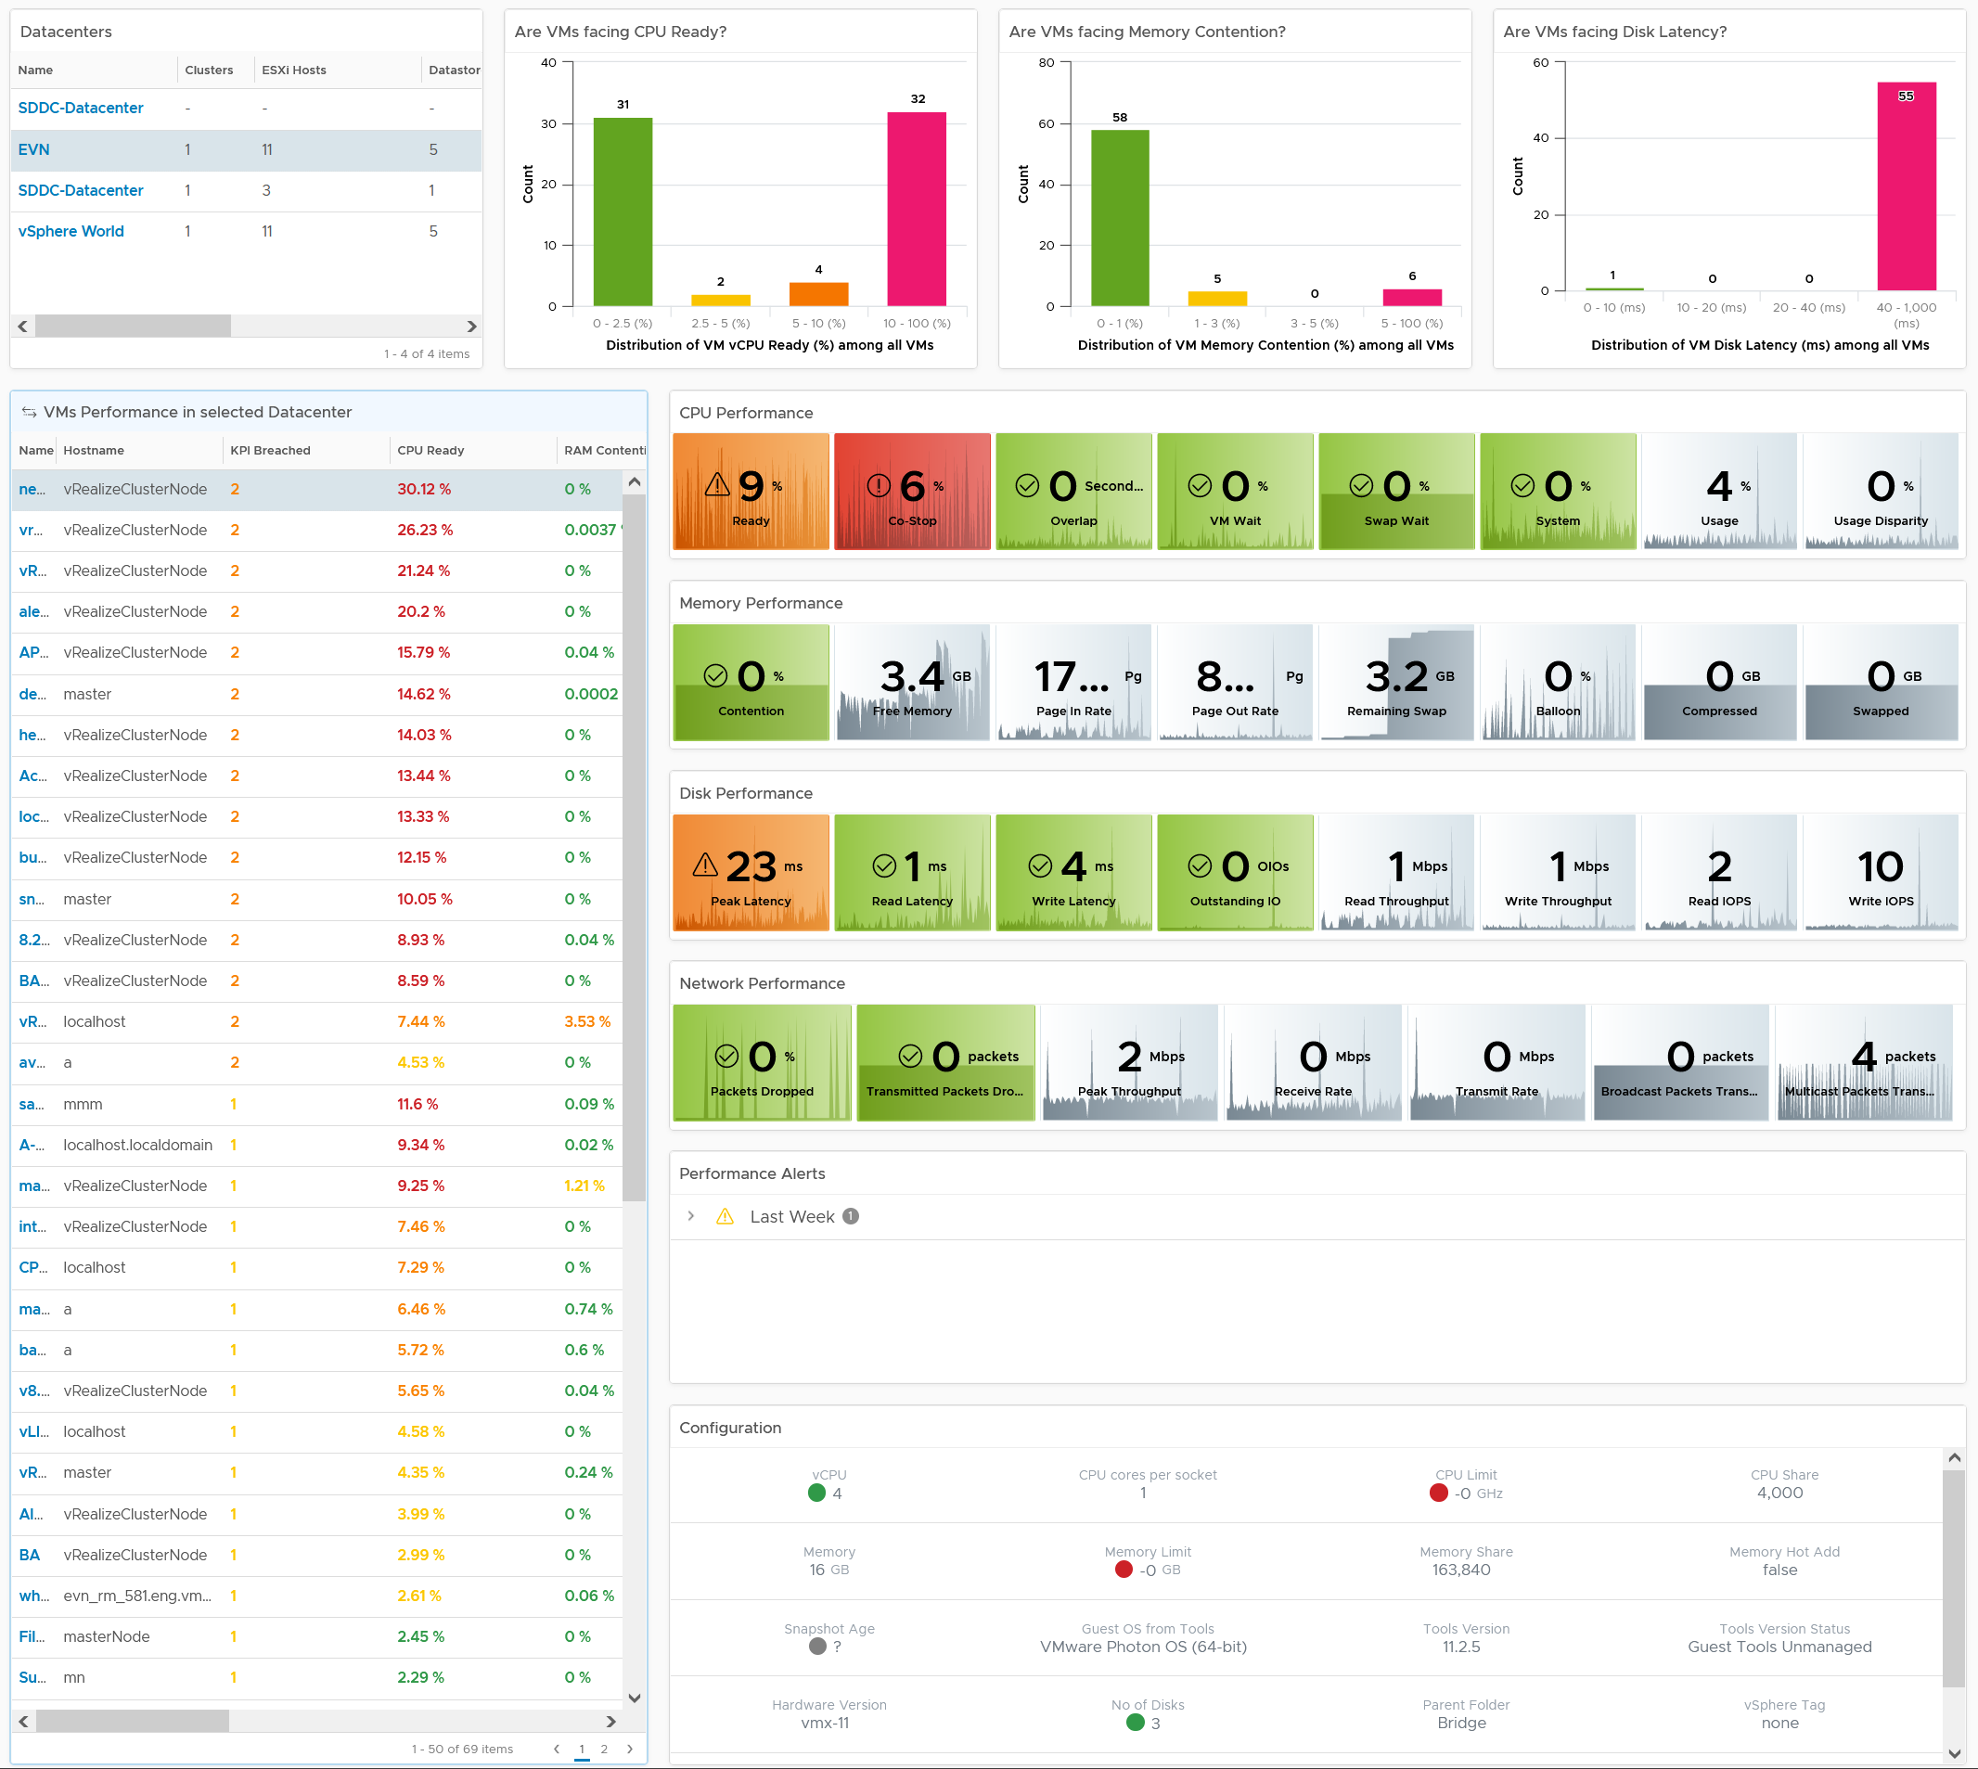
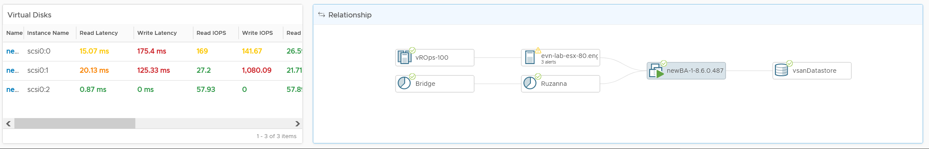
Overall Analysis
Quickly see the big picture
Pro Tip: add cluster for large environment
Analyse many VMs.
Color coded. User configurable.
Sort | Filter | Export.
Choose any time period. Peak follows!
In-page Drill down. Context retain.
KPI Metrics.
Both Contention n Utilization
Color coded.
Both breadth and depth.
31 KPI Metrics
Relevant Alerts
Only Performance alert
Relevant Configuration
…that impact performance
Virtual Disks
Drill down to Read & Write
Context
Navigate to related object
Notes:
How the previous question was answered in vR Ops.
As each customers run operations a little differently, you likely need to tailor the dashboard. Work with your TAM (if not, get one!)
Reference in the book:
Part 1: Performance Chapter
Part 2: VM metrics section in all the 4 chapters
Part 3: Performance Dashboard chapter

Slide 12
Quantifying IaaS Performance
It is serving its VMs well? Every single VM, every 5 minutes.
IaaS | VM Counter | Threshold
CPU | Ready | 2.5% | Guidance for CPU Ready is 2.5%, 5%, 10%. So 2.5% is a high standard.
RAM | Contention | 1% | Guidance for RAM Contention is 1%, 2%, 4%. If you don’t overcommit, this would be flat 0%. 1% gives some overcommit while delivering good memory performance.
Disk | Latency | 10 ms | Guidance is 10 ms, 20 ms, 40 ms. Suitable for Flash. For Hybrid, do 15, 30, 45
Network | TX Dropped Packet | 1% | Not set as 0 to avoid false positive. Discuss with network expert if you see any dropped packets as you should have 0 drop in datacenter
Measured on every single VM.
While reporting is done every 5 minutes, it has the entire 300 seconds worth of data.
It is averaged. You do not want to have per-second SLA. Your Availability SLA is measured per month, because you can’t handle per day.
Why it is a stringent threshold:
An Internal KPI for Infra team consumption, not external Formal SLA. You want internal to be higher than what you promise externally.
It works from mission critical to Dev environment
Proactive Operations requires early warning. Alerts will break down as you get too many. This requires Insight.
A single threshold keep operations simple
Dev IaaS will obviously perform worse than Prod IaaS. You pay less, you get worse performance. You pay half price, you get half the performance.
Helps to educate the difference in QoS (Quality of Service)
A cluster with 500 VM will have:
2000 data every 5 minutes.
17.5 millions metrics per month
Notes:
Key Point:
Fast or well can be quantified.
It’s not perfect for all situation, just like in real life. 37.5 degree is the threshold for fever, but you can be unwell at 36.5 and another person is fine at 38. That does not mean you abandon the threshold as it’s the only way you can scale operations.
The standard is set stringent.
Reference in the book:
Part 1 Chapter 2 Performance Management: read the “KPI SLA” section

Slide 13
A short detour into VM counters
Notes:
Why: because many customers ask for deep dive into the metrics. Escalation and confusion between Guest OS and VM
Reference in the book:
Part 2: VM metrics section in all the 4 chapters

Slide 14
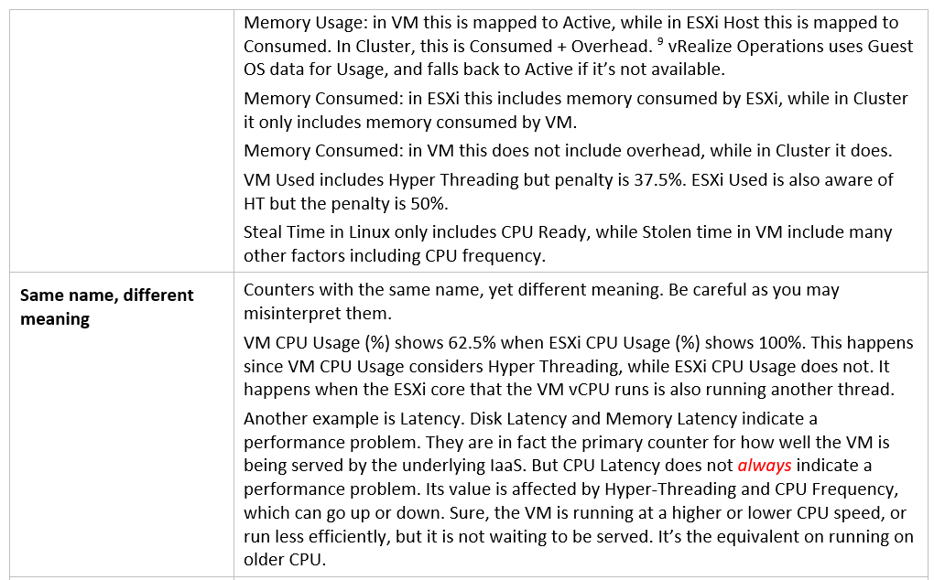
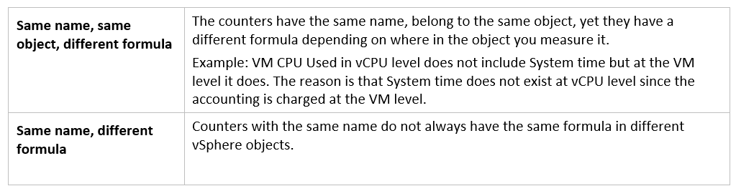
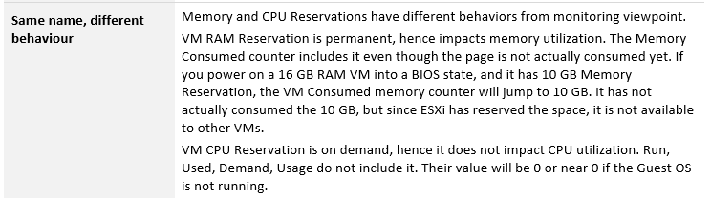
Nuances in Counters
Part 2 Chapter 1: Metrics Overview
Group Discussion
Why are they so many nuances created when a new layer is added?
What can we do to hide the raw complexity from L1 team? Can we create higher level metrics with color coded range?
Notes:
Point of this slide: after almost 2 decades, we’ve taken virtualization counters for granted. How has that created problems, and what can we do about it?
Reference in the book:
Part 2 Chapter 1 Overview: read the “Nuances in Metrics” section.

Slide 15
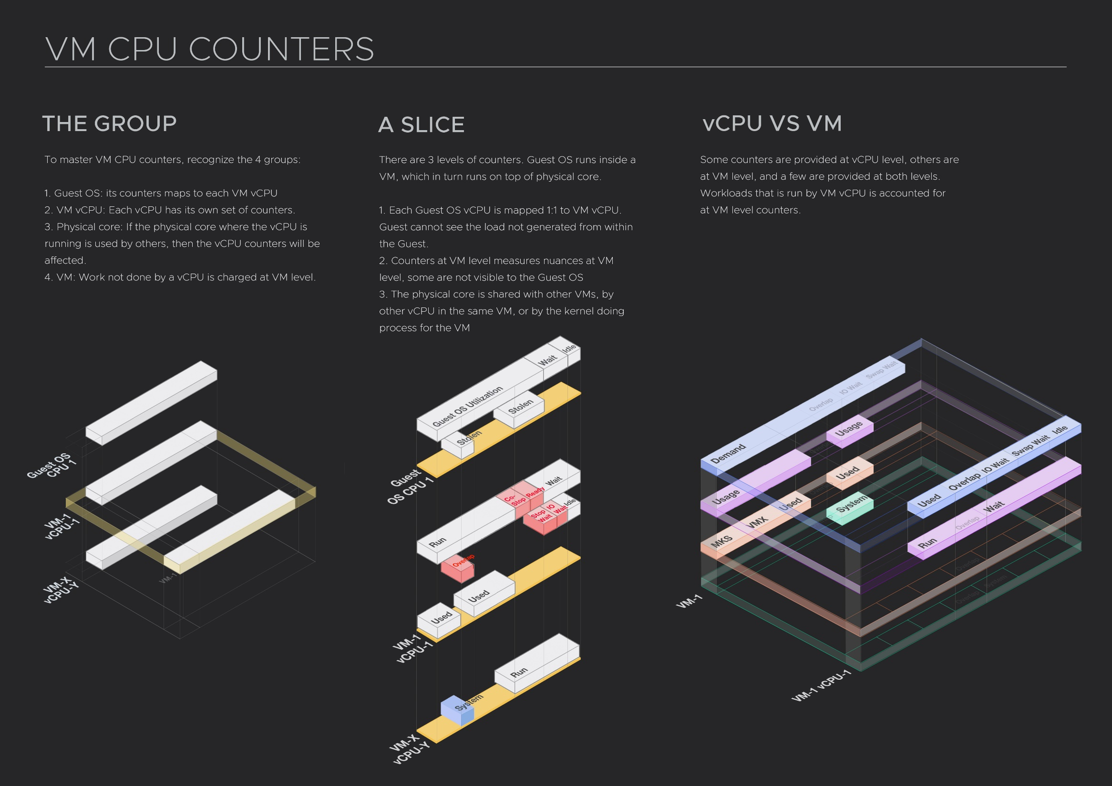
Notes:
Note. This diagram does not exist in the book as it’s a summary diagram. The book explains in greater depth so it requires a more detail version
Reference in the book:
Part 2 Chapter 2 CPU Metrics: read both the Guest OS and VM sections

Slide 16
CPU Counters: VM vs Guest
Different vantage point
What Hypervisor sees
What Guest OS sees
8 vCPU
Run Queue
Wait
Wait
Swap Wait
Idle
IO Wait
Usage
(GHz)
vCenter only
Used
Demand
(GHz)
Run
Utilization
Context Switch
Overlap
0 vCPU
Stolen
System
MKS
Co-Stop
Ready
Limit
Notes:
Note. This diagram does not exist in the book as it’s a summary diagram. The book explains in greater depth so it requires a more detail version
This diagram applies the knowledge to use cases such as Guest OS Right-size, VM reclamation and Workload Placement. The first use case looks has to look inside the Guest OS, while the second & third looks at the impact on the ESXi. You will see that the different vantage point results in different counter.
Reference in the book:
Part 1 Chapter 3 Capacity Management: read the reclamation and rightsizing sections
Part 2 Chapter 2 CPU Metrics: read both the Guest OS and VM sections

Slide 17
VM RAM Counters
Don’t confuse space vs speed
What Hypervisor sees
What Guest OS sees
Page File
Page File Used
8 GB
Page Out
Page In
Swap File
Swapped
Hardware Reserved
Swap In
Swap Out
Balloon
Guest Free
Balloon Target
Shared Saved
Granted
Compressed Saved
Guest Cache/Buffers
Compressed
Windows Modified
Consumed
Linux “Used”
Balloon
Shared
Zip
Unzip
Windows “In Use”
Balloon
Windows “Compressed”
Reservation
Active
0 GB
Overhead
Notes:
Note. This diagram does not exist in the book as it’s a summary diagram. The book explains in greater depth so it requires a more detail version.
Reference in the book:
Part 2 Chapter 3 Memory metrics.

Slide 18

The Ask from Your Manager
Prove that your IaaS is serving all the VMs well.
Every 5 minutes. Without fail
CPU. RAM. Network. Disk
Every single VM. No one left out.
You have 10K VMs. How to prove?
Notes:
Point of this slide: Senior IT Leadership cares more about the dining area than the kitchen. At least they start from there, before discussing system architecture.
You CIO called you to her office. She is very pleased with your business plan to virtualize the remaining 20%. You’ve virtualized 80% of the environment and saves company a lot of money.
She just have 1 ask.
How do we prove that… not a single VM… in any service tier… fails the SLA threshold we agree for that tier?
Since it is IaaS, that means CPU, RAM, Disk and Network, the 4 main components of Infrastructure.
She wants to see the data captured every 5 minutes. 24 x 7.
Yup, she is asking for a proof.
Reference in the book:
Part 3 Chapter 7: Executive Summary Dashboard

Slide 19
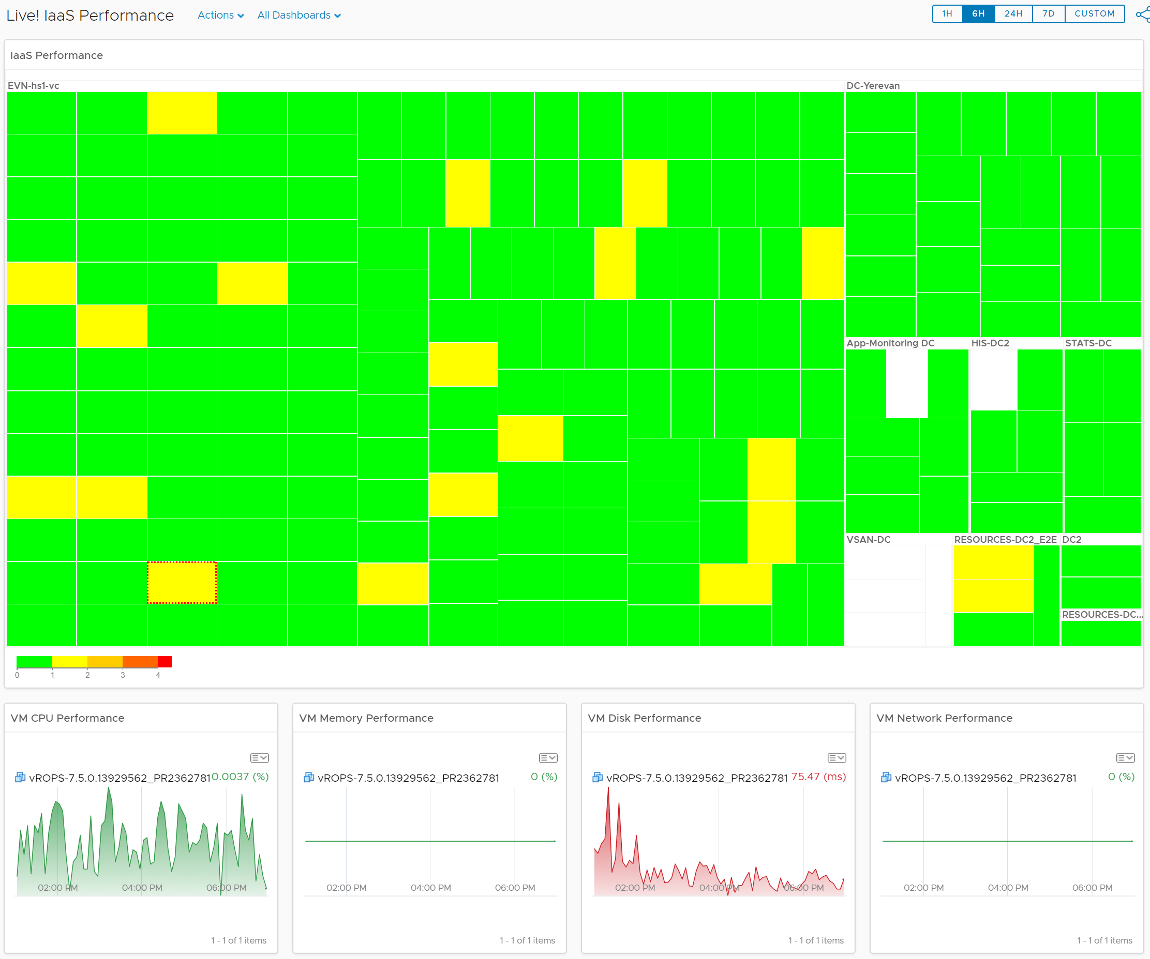
Live Performance
IaaS Performance
Not VM performance
0 – 4 maps to the 4 elements provided by IaaS
4 SLA per VM
CPU Ready
RAM Contention
Disk Latency
Network Dropped Packets
Each box is a VM
Grouped by Cluster
Customization idea:
Group by Class of Service
1 dashboard per class of service
Notes:
Note this is a custom dashboard, not OOTB. Having said that you can create it, no super metric required.
Point of this slide: you can create a set of auto-rotating dashboard that covers different topics
Reference in the book:
Part 3 Chapter 6: NOC Dashboard

Slide 20
Proactive Operations
Away from Complaint-based Operations
KPI should help you toward Insight-based Operations, not Alert-based. Less hectic.
Red does not mean emergency and you drop everything.
If the dashboard shows mostly Red, and there is no complaint, that’s Proactive Operations. Your internal threshold is giving early warning, so you can make business call to improve in calm environment.
Take a look today, not immediately.
Take a look this week
Early Warning. Could be false positive
Great!
Notes:
Point of this slide: you want to change mindset from fire fighting to calm operations
Reference in the book:
Part 1 Chapter 2 Performance: read the “Insight vs Alert” section.
Part 3 Chapter 6: NOC Dashboard

Slide 21
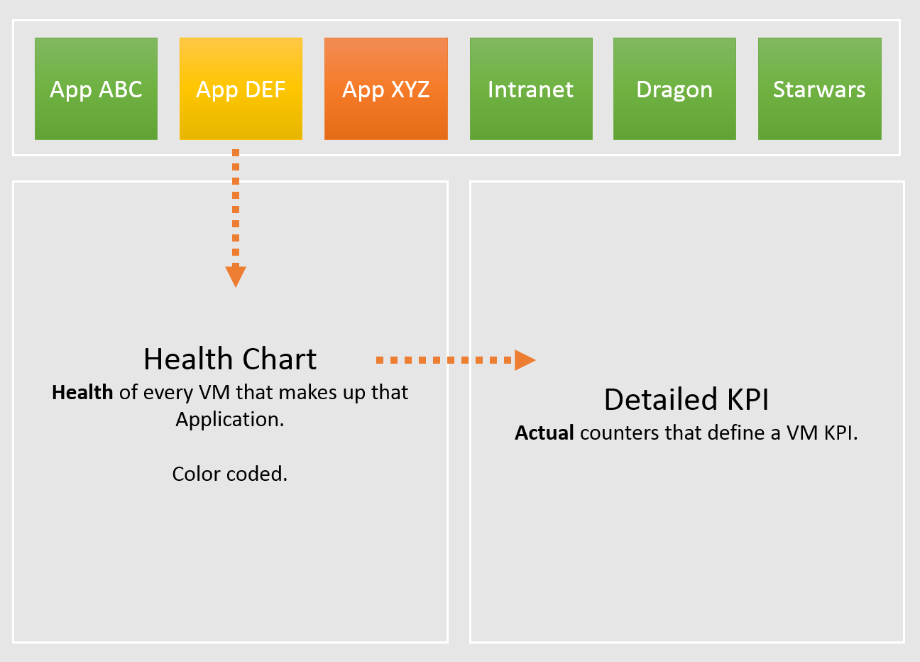
Tier 1 Business Applications
If business is affected, is it because of Infra? Be transparent and details
Mission Critical Business Systems.
Keep to Top 10 only. #11 is definitely less critical than #1, so focus on the top 10 first. Once settled then expand
No non-critical systems shown. Different threshold.
On the big screens.
For all System Owners to see. Transparency builds trust.
Color coded. Threshold based. Easy to see pattern.
Goes deep.
Drill down to actual raw counter.
Cover both contention & utilization.
Notes:
Point of this slide: you can actually create a biz app dashboard.
Another area where CIO cares is applications. By that we meant business application, not individual ISV products (e.g. MongoDB, Apache Tomcat).
Since they serve different business purpose, using different softwares, but run on the same IaaS, how do prove they are all performing well?
Reference in the book:
Part 3 Chapter 9 Other Dashboards: Read the “Multi-tier Applications” section. Note this is not OOTB.

Slide 22
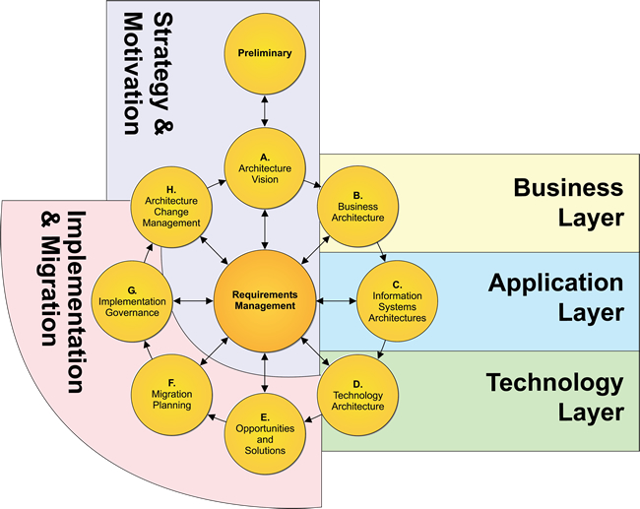
3 Levels of Monitoring
Different teams → different responsibility → different questions
Layers
Sample Metrics
Business
Business Results
How much sales do we make today?
How many customers buy our products this week?
On average, how long did the XYZ transaction take this hour?
How many customers login yesterday?
On average, how long do they stay?
Business Transaction
Application
Individual Node
How long does SQL Query ABCD take in the past 7 days?
What’s SQL Server free memory value 1 hour ago?
What’s the overall application uptime?
Are my apps configured for performance?
Vertical
Metrics depends on each apps and needs
“The System”
IaaS
VM or Container
What’s Windows CPU Run Queue?
What’s the peak VM CPU Contention in the past 24 hours?
What’s the total IO hitting vSAN from 9 – 6 pm yesterday?
What’s the buffer in physical switch right now?
Virtual Infra
Horizontal
Common Metrics applicable for all apps
Physical Infra
Notes:
There are 3 distinct layers. Our approach is bottom up, since we focus on Infrastructure layer. IaaS is your business. You need to get your own house in order before attempting to fix other people problem.
Reference in the book:
Part 1 Chapter 2: Performance Management

Slide 23
KPI for Multi-tier Application
1 metric per business application
Load balancer
Load balancer
Web Server
Web Server
Web Server
Web Server
Biz App KPI = Worst (App Tier KPI)
A tier performance can impact other tiers
Load balancer
Load balancer
App Server
App Server
App Server
App Server
App Tier KPI = Average (VM KPI) Has to be average, else a single VM dominates entire business applications. In a large business system with many VM, this can be too aggressive, resulting in too many alerts. Alerts fatigue.
DB Server
(Active)
DB Server
(Passive)
Notes:
An Application spans multiple VMs, and has multiple tiers. It might include physical servers. It might also include non-servers, e.g. Load Balancers.
An Applicaton spans multiple software and Guest OS.
An Application may use all styles of containment: physical server, VM, container and serverless.
An Application may span multiple physical location. It uses global load balancers.
LB can be physical, virtual, or a service.
Implementation at vR Ops: Each Tier should be a group or tag or Application Tier
Reference in the book:
Part 3 Chapter 9 Other Dashboards: Read the “Multi-tier Applications” section. Note this is not OOTB.
Part 4 Chapter 4 Super Metrics.

Slide 24
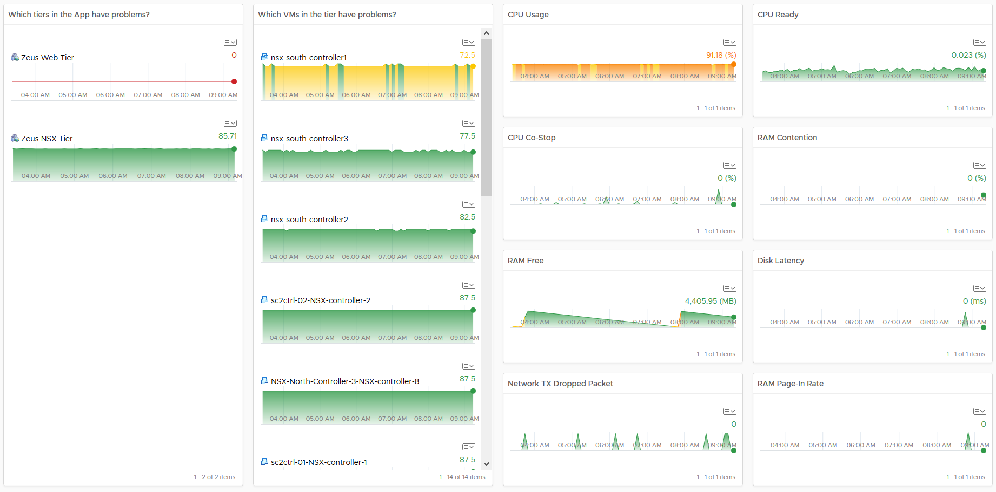
Notes:
List of Tier 1 applications. Avoid listing all applications, as it will cluster the screen. Not all apps deserve to be on the front page, as the monitoring team will be overwhelmed.
Note. The version in the book is more advanced, but more complex. As it’s a custom dashboard, there are multiple possibilities.

Slide 25
VM KPI Counters
Utilization is included due to 300-second averaging
CPU
RAM
Network
Disk
Inside Guest OS
(Linux, Windows)
Run Queue
Context Switch
Paging Rate (MB/s)
Committed %
OS Output Queue Length
Driver Queue
OS Queue
Driver Queue
Utilization
In Use
Modified + Standby
Throughput (Mbps)
Latency
Latency
Outside Guest OS
Run | Used
System + VMX + MKS
Active, Consumed, Granted
Swapped
Throughput
IOPS.
Throughput (Large Block)
Ready + Co-Stop + Overlap
IO Wait + Swap Wait
Contention
TX Dropped Packet
Normalized Latency
Outstanding IO
Latency
Other performance counters:
vMotion stun time. Reported by Log Insight
NUMA migration Reported by ESXCLI
P-State & Xeon Hyper Thread effect. Reflected by Used, Usage, Demand
Notes:
Point of this slide: there are actually many metrics that measures the VM, as VM and Guest OS are often treated as 1 object.
Reference in the book:
Part 1 Chapter 2 Performance Management: read the “Optimized Performance” section

Slide 26
KPI of a single VM
How do we define the performance of a single VM, from infrastructure viewpoint?
 | Metric | Green | Yellow | Orange | Red
Guest OS Contention | Total CPU Run Queue | 0 – 5 | > 5 | > 10 | > 20
 | CPU Context Switch Rate | 0 – 5K | < 25K | < 100K | > 100K
 | Total Disk Queue Length | 0 - 25 | > 25 | > 50 | > 100
Guest OS Usage | RAM Free (MB) | > 512 MB | > 256 | > 128 | ≤ 128
 | RAM Page-in Rate (KB/s) | 0 – 25K | > 25K | > 50K | > 100K
VM Contention | CPU Co-Stop (%) | 0 – 2.5% | > 1 | > 3 | > 5
 | CPU Ready (%) | 0 – 2.5% | > 2.5 | > 5 | > 7.5
 | Total CPU Overlap (ms) at VM level | 0 – 1000 | > 1000 | > 2500 | > 5000
 | CPU IO Wait | 0 – 1000 | > 1000 | > 2500 | > 5000
 | RAM Contention (%) | 0 – 1% | > 1 | > 2 | > 4
 | Disk Latency (ms) | 0 – 10 ms | > 10 | > 20 | > 40
 | Disk Outstanding IO
 | Network TX Dropped Packet | 0 | > 0 | > 1 | > 2
VM Usage | CPU Usage (%) | 0 – 85% | > 85 | > 90 | > 95
Proactive, not alert based
Red does not mean emergency. It means you need to take a look within a few days.
Limitation
Can be enhanced to support different class of service, but steps are complex ;-)
Notes:
Reference in the book:
Part 1 Chapter 2 Performance Management: read the “Optimized Performance” section

Slide 27
Logic
Metric | Green | Yellow | Orange | Red
VM Disk Latency (ms) | 0 – 10 ms | > 10 ms | > 20 ms | > 30 ms
Guest OS RAM Free (GB) | > 512 MB | > 256 MB | > 128 MB | ≤ 128 MB
Remove the units.
Translate into a unitless range
0 - 25
25 - 50
50 - 75
75 - 100
Take Mid-Point to represent
12.5
37.5
62.5
87.5
If CPU Usage > 90 Then RED Elseif CPU Usage > 80 Then ORANGE Then Elseif CPU Usage > 70 Then YELLOW Else GREEN
If CPU Usage > 90 Then 12.5 Elseif CPU Usage > 80 Then 37.5 Then Elseif CPU Usage > 70 Then 62.5 Else 87.5
Notes:
Limitation: Green can’t exceed 87.5, and Red won’t drop below 12.5
Part 4 Chapter 4 Super Metrics provide a more advance formula that addresses the above limitation. It’s able to provide a range for each color equally.

Slide 28
KPI of a single VM: Example
The relative movement is more important than the absolute number
Metric |  | Green | Yellow | Orange | Red | Value
Guest OS | CPU Run Queue per vCore | 0 – 1 | 1 – 2 | 2 – 3 | > 3 | 87.5
Guest OS | CPU Context Switch | 0 – 1K | < 10K | < 100K | > 100K | 37.5
VM | CPU Usage (%) | 0 – 70% | > 70% | > 80% | > 90% | 37.5
VM | CPU Co-Stop (%) | 0 – 2.5% | >2.5% | > 5% | > 7.5% | 12.5
VM | CPU Ready (%) | 0 – 2.5% | > 2.5% | > 5% | > 7.5% | 62.5
VM | RAM Contention (%) | 0 – 1% | > 1 | > 3 | > 5 | 62.5
Guest OS | RAM Free (GB) | > 512 MB | > 256 MB | > 128 MB | ≤ 128 MB | 62.5
Guest OS | RAM Page-in Rate as a % of Used | 0 – 1% | > 1 | > 3 | > 5 | 87.5
VM | Disk Latency (ms) | 0 – 10 ms | > 10 | > 20 | > 30 | 87.5
VM | Network TX Dropped Packet | 0% | > 0% | > 1% | > 2% | 87.5
 | KPI |  |  |  |  | 62.5
Notes:
Part 4 Chapter 4 Super Metrics provide a more advance formula that addresses the above limitation. It’s able to provide a range for each color equally.

Slide 29
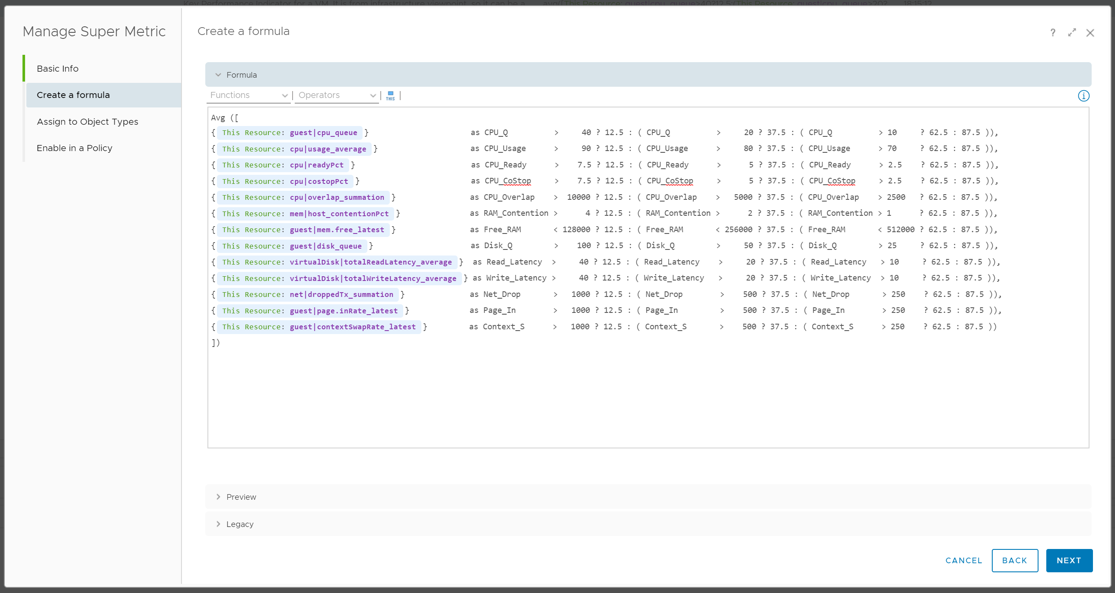
VM KPI: Implementation
Super metric used to create VM KPI metric
Notes:
Part 4 Chapter 4 Super Metrics provide a more advance formula that addresses the above limitation. It’s able to provide a range for each color equally.

Slide 30

Purpose-driven Architecture
You buy SDDC from vendors. You sell IaaS to your customers.
Purpose
Serve the VMs & Applications
KPI
Is it serving the VMs well?
Is it serving the Applications well?
Cost
Lower than Public Cloud, especially VMware-based
Pillars
Class of Service
Performance SLA + Availability SLA
Proof of Success
Proactive Operations, not Complaint driven
Insight-based, not Alert-based
Notes:
Point of this slide: Begin with the end in mind
Reference in the book:
Part 1 Chapter 1 Overview: read the Purpose-Driven Architecture section

Slide 31

The difference between Enteprise-grade Cloud and
non Enterprise-grade Cloud is…
SLA
The hardware, the process, the skills, the technology are just mechanism to achieve what you promise in the contract
Notes:
Point of this slide: SLA is expected.
Reference in the book:
Part 1 Chapter 1 Overview: read the Service Level Agreement section

Slide 32
Class of Service
Price/Performance. Formally defined
Tier | Price | Overcommit | Performance | Positioning
Gold | Highest | 1:1 | Perfect (100%) | Performance Guarantee. Suitable for latency-sensitive applications.
Silver | Moderate (50% of Gold) | 1:2 | Great (95%) | 50% discount for only 5% penalty. Suitable for most Production workload.
Bronze | Low (25% of Gold) | 1:4 | Good (90%) | 75% discount for only 10% penalty. Suitable for Test & Dev workload.
Free | Free! (funded by higher tiers) | 95% Utilization | Best Effort (85%) | Suitable for temporary project. No Availability SLA, no Performance SLA
Hardware is identical for all tiers.
Notes:
Point of this slide: SLA needs to start at Day 0.
Reference in the book:
Part 1 Chapter 1 Overview: read the Service Level Agreement section

Slide 33
IaaS Operations Maturity
Journey towards SLA-based IaaS
Reactive
Internal KPI
Formal SLA
SLA is part of business contract.
Customers can track the SLA via self-service portal.
1 policy for each SLA
IaaS Performance is quantified & measured.
Performance is based on Production environment
Default policy.
Complaint-based Operations
Blamestorming
IaaS Performance measured based on Business impact
You walk from where you stand. Adopt Internal SLA first.
Notes:
Point of this slide: If you do not have Formal SLA, then don’t jump into it until you know your own, actual, performance. Quantify your real numbers.
Reference in the book:
Part 1 Chapter 1 Overview: read the Service Level Agreement section

Slide 34
Before and After SLA is breached
Early Warning and Automatic Remediation
The time your customers know it’s a problem if you do nothing
The time you know it’s a problem
If you do not
have performance threshold, you cannot be proactive
Early Warning
via Leading Indicators
Complaint-based
Operations
Automatic Remediation
Insight
Alert
Examples:
VM CPU Ready > 5%
VM CPU Co-Stop > 2.5%
VM CPU IO Wait > 1%
VM individual Virtual Disk Read Latency > 10 ms
Upward anomaly % of VMs with CPU Ready > 1%
vMotion stun time > 0.2 second
ESXi VMkernel queue > 1 ms
Examples:
SLA: VM CPU Ready > 5%
VM Disk Latency > 10 ms (average of read/write for every disks)
Notes:
Point of this slide: how do you apply early warning without getting excessive alerts?
Reference in the book:
Part 1 Chapter 1 Overview: read the Insight vs Alert section

Slide 35

A formal event with ticket recorded in the system.
Response mandatory.
Immediate timeline (hours).
Reactive.
Management by Exception
Alert
Insight
Not a formal event.
Does not require immediate response.
Longer timeline (days - weeks)
Proactive. No alert generated, no alert storm. Use dashboard to find out.
Management by knowing the Big Picture
Notes:
Point of the slide: what can you do to drive with Insights instead of Alerts?
Reference in the book:
Part 1 Chapter 1 Overview: read the Insight vs Alert section

Slide 36
Performance Profiling
Based on millions of datapoints in actual environment
Example: 10K VM x 3 months
5 minute = 1 datapoint.
1 day = 288 datapoints
3 months = 26,298 datapoints.
Required if you want to capture quarter end peak.
Else do 1 month.
10K VM = 262,980,000 datapoints!
Repeat per cluster
You might be surprised with their relative performance
Tier 1 cluster may perform worse than Tier 2
 | 00:00 | 00:05 | 00:10 | 3 months
VM 001
VM 002
VM 003
VM ###
All VM | Depth Counter Breadth Counter | Depth Counter Breadth Counter | Depth Counter Breadth Counter | Depth Counter Breadth Counter
Cluster | 99th percentile of 3 months |  | Analysis (based on 5% as SLA)
 | Depth | Breadth
Cluster 01 | 4.9% | 5.3% | SLA of 5% is suitable. The worst is 4.9%, near but below the SLA. Only ~5% is above half the threshold, so the other 95% is below half.
Cluster 02 | 3.5% | 62.8% | Ideal scenario. Cluster performance is very consistent, but near “full”. Worst is well below SLA.
Cluster 03 | 19.2% | 2.5% | Something wrong. Cluster performance is unbalanced. A few VM gets really bad experience. Investigate first.
Notes:
Point of the slide: You can profile the actual performance
Reference in the book:
Part 1 Chapter 2 Performance Management: read the Baseline Profiling section

Slide 37

What’s my overall Performance? Overall Capacity?
Hard to answer, especially in large environment
Aggregation is misleading
Members are not interchangeable. Examples:
Can’t put business VM into NSX Edge cluster
Can’t move Singapore load to New York
Show a trend line. 1 trend line, not many trend lines.
Show a table, listing all members (e.g. clusters).
Each table does not show average. It shows Peak + 95th percentile.
Drill down In-context.
Solution
Average is useless
Average of a large number does not give reaction time operationally. 95th percentile better.
Need to show across time
Can’t average 3 months information into 1 data point.
Patterns are important (weekday vs weekend, business hours, etc.)
Need to drill down in context
Quickly see the detail of selected member.
Not losing the big picture, and can rapidly toggle among members for analysis
Notes:
Point of the slide: Rolling up is hard. You either take the extreme (outlier) or you lose the details (by averaging).
Reference in the book:
Part 2 Chapter 1 Overview: read the Collection | Aggregation section

Slide 38
Performance vs Capacity
Context: IaaS
Focus
Time
Counter
Availability SLA
Utilization
IaaS Performance
VM How the IaaS serves its VMs
1 second – 5 minutes
Contention. Utilization is for troubleshooting, not monitoring.
Does not take into account. Not relevant
Based on raw. Usable Performance
IaaS Capacity
IaaS VM Capacity Management is merely right sizing
1 month – 1 year
Utilization. So long there is no contention.
Takes into account. Tier 1 is in fact Availability-driven.
Based on usable. Usable Capacity vs Total Capacity
Notes:
Point of the slide: 2 sides of the same coin. Related but not the same.
Reference in the book:
Part 1 Chapter 2 Performance: read the Performance vs Capacity section

Slide 39
Utilization
Just a means to an end. It’s not something you manage
Utilization depends on the purpose.
Different goal → different interpretation and metrics
Performance
100% utilization is not only good, it’s perfect. So long there is no queue, drive this high
Low utilization may mean bad performance. Check Q
Look at actual utilization. Ignore Buffer and HA.
Use 5 minute interval. If you suspect Peak, then zoom into 1 minute
Look at 1 day time period
Capacity
100% utilization is bad, especially it breaches Usable Capacity
Low utilization always mean good capacity
Look at relative utilization. Include Buffer and HA.
Use hourly or daily average. Peak is taken care of by measuring contention directly.
Look at 3 – 6 months
Notes:
Point of the slide: do not manage utilization as its meaning depends on the purpose
Reference in the book:
Part 1 Chapter 2 Performance: read the Performance vs Capacity section

Slide 40
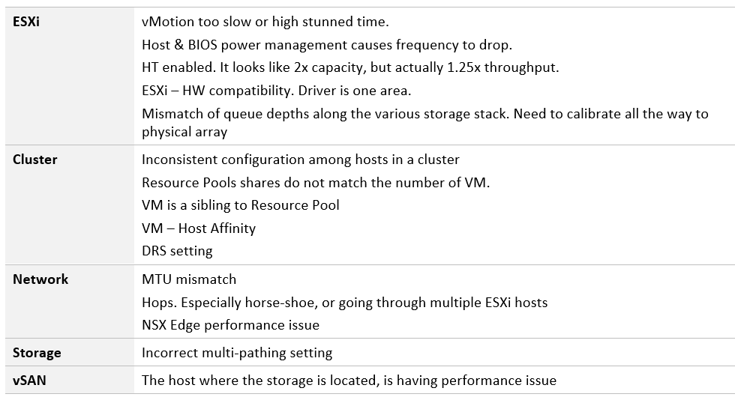
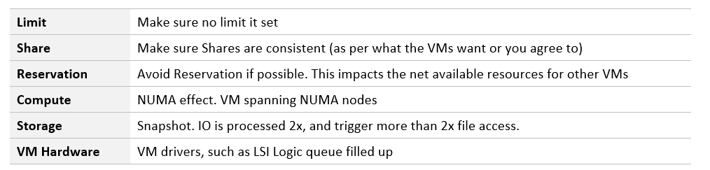
Low Utilization, but Bad Performance
Many things can cause. Here are just some
Notes:
Point of the slide: Possible because utilization looks at provider, while contention looks at consumer
Reference in the book:
Part 1 Chapter 2 Performance: read the Contention vs Utilization section

Slide 41

Introducing….
The counters to quantify IaaS performance
=
Performance SLA met?
x
VM Perf. Threshold (%)
100%
CPU
RAM
Disk
Net
=
Σ
Cluster Performance (%) VM Perf. Threshold (%)
Above is calculated every 5 minutes. Aim for 99.9% Internal SLA per month
Notes:
IaaS provides 4 types of resources (CPU, RAM, Disk, Network) to every VM. Each type has SLA. We count each failure. A VM may experience 0 – 4 SLA failures.
To compare across many clusters (who have different no of VMs), we divide by no of running VMs. We calculate every 5 minutes, as no of VMs are not static.
To ease monitoring, we present the number in %. SLA Failure can range from 0% (no failure) to 100% (all failures)
Reference in the book:
Part 1 Chapter 2 Performance: read the “KPI vs SLA” section

Slide 42
2 dimensions of Performance
How Deep vs How Broad
How severe is the problem?
What’s the worst that happens to a single VM.
Once you know this, the next logical question is below.
How widespread is the problem?
How many VMs are affected?
The answer impacts the course of troubleshooting. Is it isolated incident or widespread?
Isolated → look at the affected VM more closely
Widespread → look at common area (e.g. cluster, datastore, resource pool, host)
 | Metric | Green | Yellow | Orange | Red
How Broad? | % VM with CPU Ready >1% | <2.5% | < 5 | < 10 | > 10
 | % VM with RAM Contention >1% | 0% | < 2.5 | < 5 | > 5
 | % VM with Disk Latency >10 ms | 0% | < 2.5 | < 5 | > 5
How Deep? | Max VM CPU Ready | < 2.5% | < 5 | < 7.5 | > 7.5
 | Max VM RAM Contention | < 1% | < 3 | < 5 | > 5
 | Max VM Disk Latency | < 10 ms | < 20 | < 30 | > 30
Notes:
Point of the slide: using 2 dimensions make it easier than 1.
Reference in the book:
Part 1 Chapter 2 Performance: read the “Breadth vs Depth” section

Slide 43
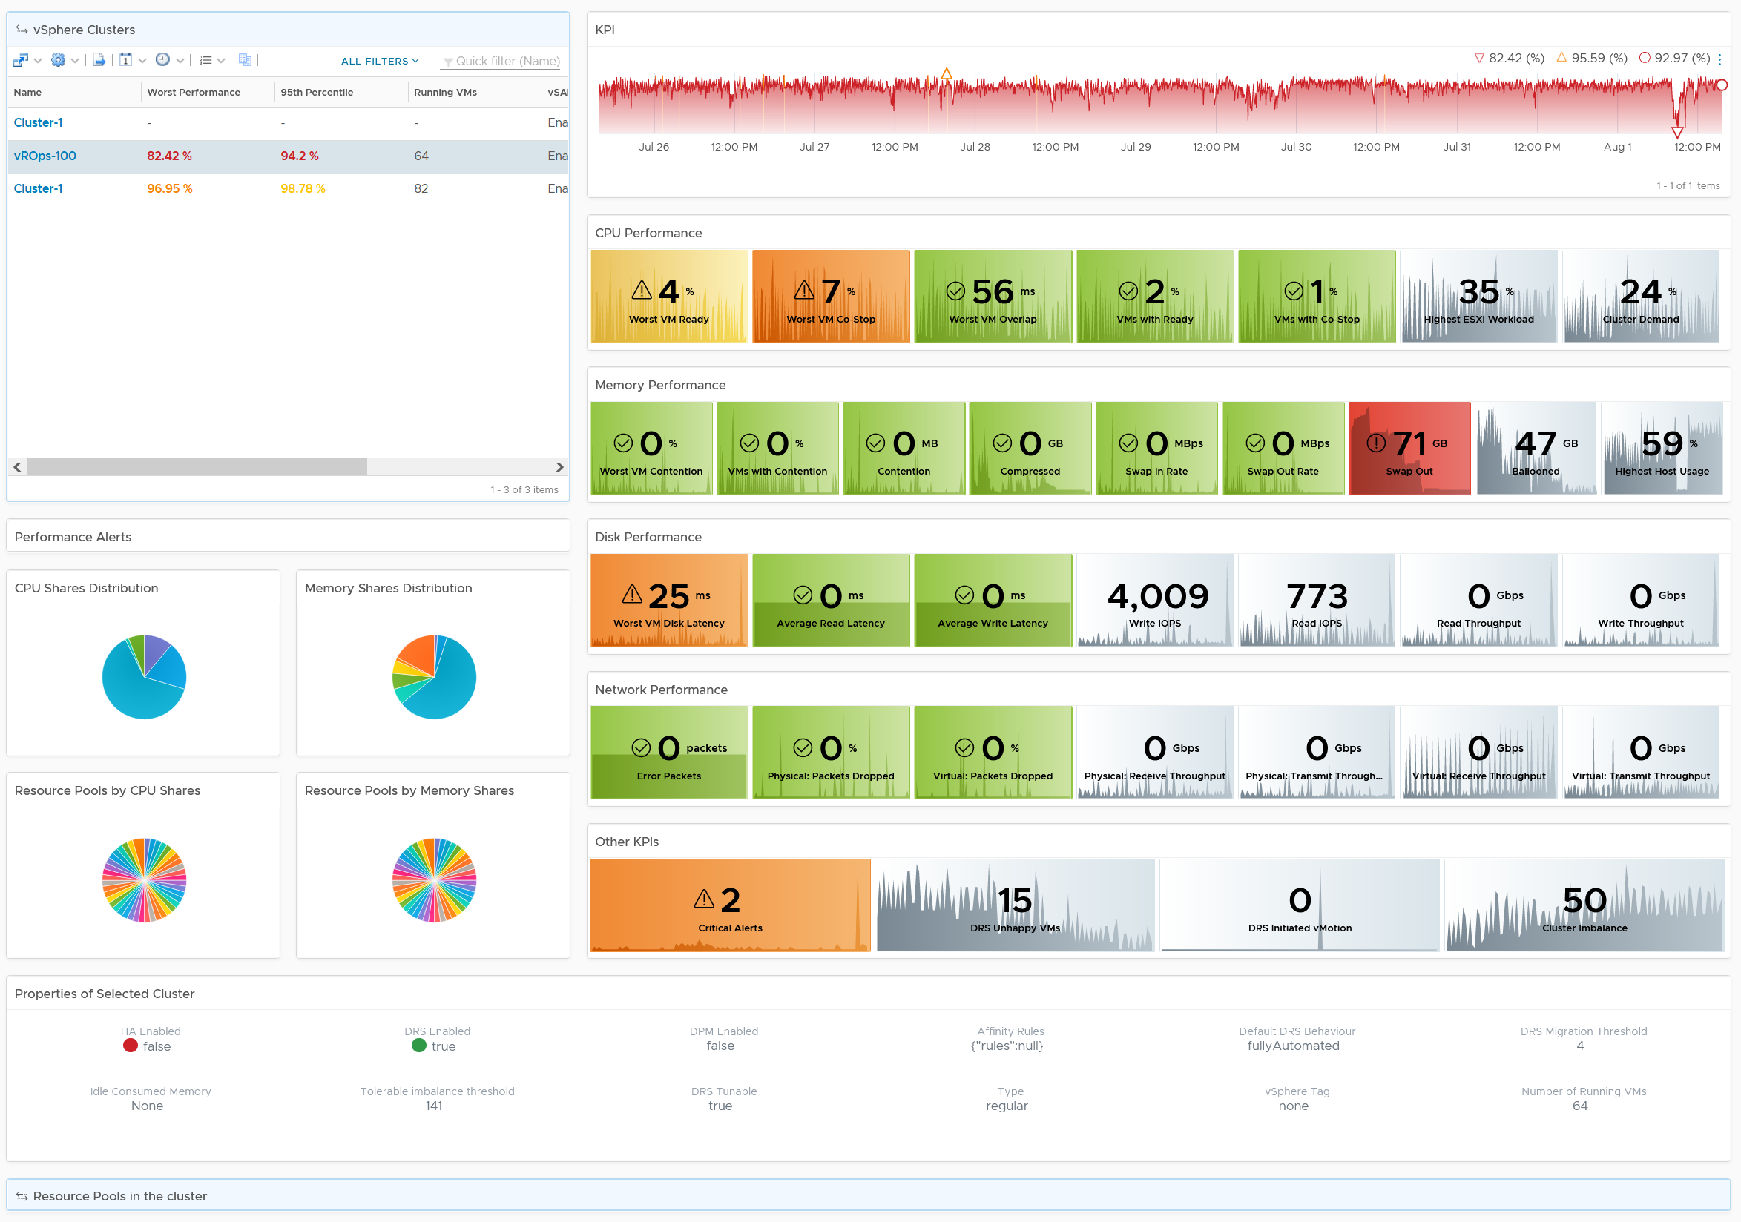
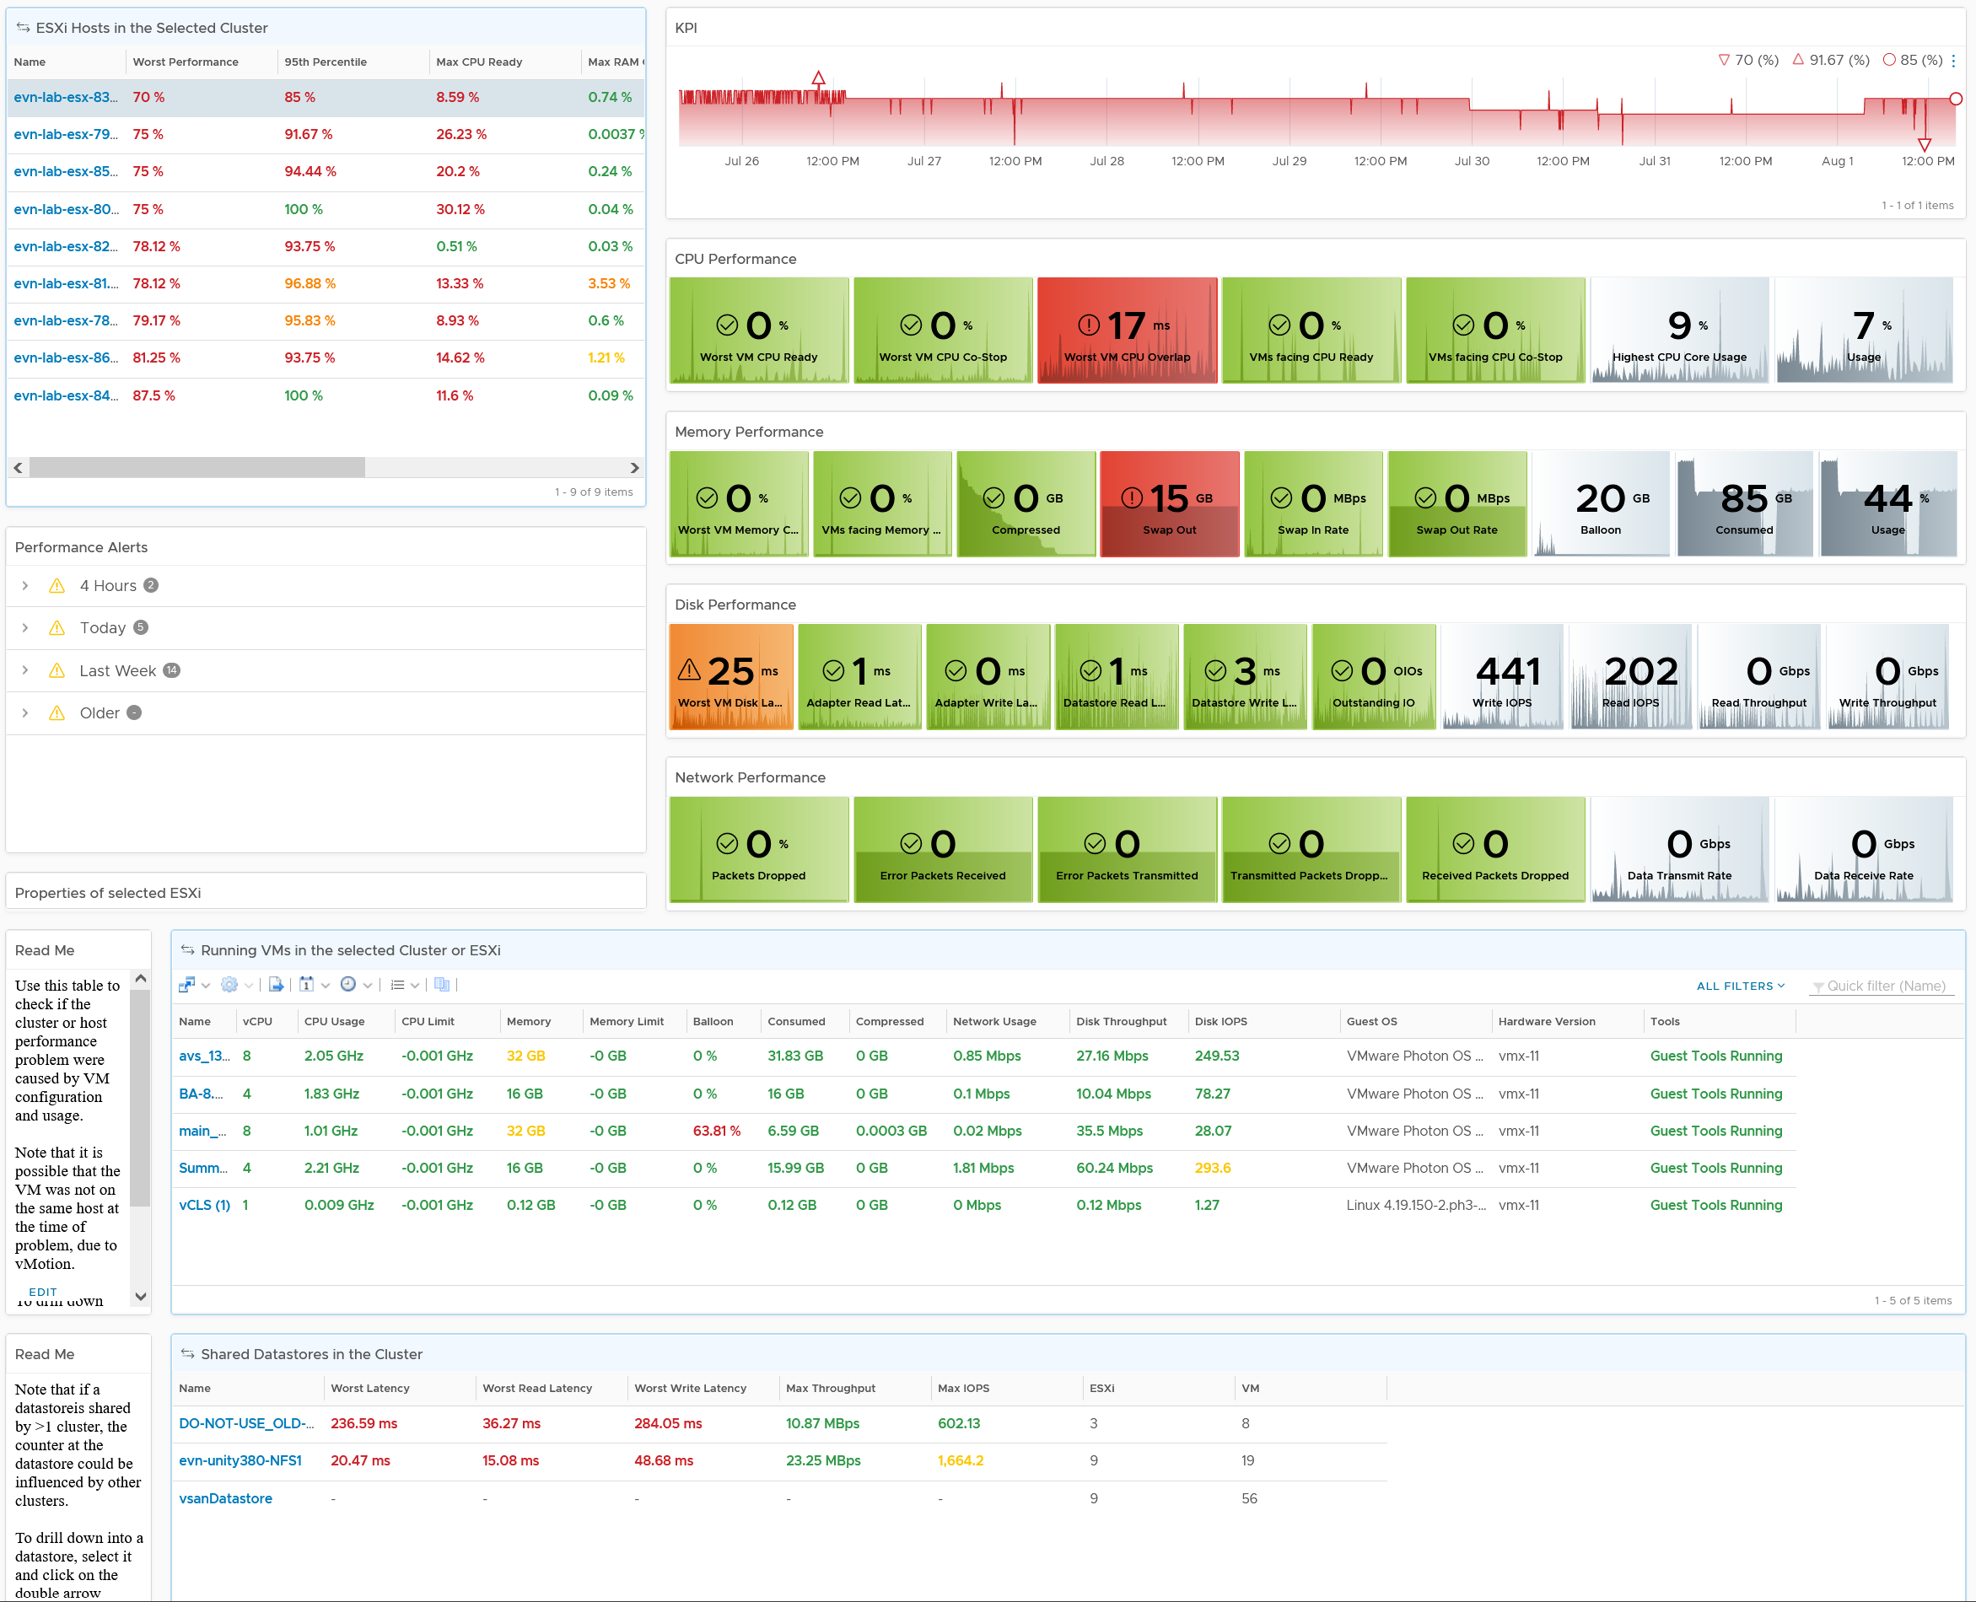
Level: Cluster
Clearly shows where the problem is
KPI line chart shows health trend over time
CPU | Memory | Disk | Network
Absolute value and Relative movement
Analyse
Many Clusters
KPI Metrics.
Contention
Utilization
Alerts
Shares
Resource Pool
Relevant
Configuration
Level: ESXi
Analyse
Many ESXi
KPI Metrics.
Contention
Utilization
Alerts
Configuration
Analyse
Many VMs
Level: VM
Analyse
Many Datastores
Datastore
Notes:
Point of the slide:
Clearly show what the problem is
Read or Write?
Received or Transmit?
Contention caused by high utilization?
Relevant alerts added.
Relevant configuration added
Drill down
Resource Pool is now added. It’s missing in 8.2
In-place drill down to ESXi. No need to context switch into another dashboard.
More with Less
Less dashboard but more info.
Optimized for larger monitor
Great excuse to get that 4K monitor. E1 uses 43” and he recommends one. You’re welcome.
Reference in the book:
Part 3 Chapter 2 Performance Dashboard: read the Cluster Performance dashboard

Slide 44
Monitoring a vSAN cluster
vSAN Cluster
10 ESXi, 40 NICs, 10 vSAN network, 20 Cache Disks, 120 Capacity Disks
Is any of the ESXi running high CPU utilization?
Is any of the ESXi running high Memory utilization?
Is any of the NIC running high utilization?
40 TX and 40 RX. Keep all below 80% utilization.
Is vSAN vmkernel network congested?
Is the Read Cache used?
Is the Write Buffer sufficient?
Is the Cache Tier performing fast?
Each disk has Read Cache Read Latency, Read Cache Write Latency, Write Buffer Write Latency, Write Buffer Read Latency
Total 4 x 20 = 80 counters to check.
Is the Capacity Disks performing fast?
Check both Read and Write latency.
Total 120 x 2 = 240 counters.
Is any of the Disk Group running low on space?
Is any of the Disk Group facing congestion?
Keep each <60.
Count the number of occurance >60
Is there outstanding IO on the Disk Group?
ESXi
ESXi
ESXi
ESXi
530 instances of metrics to check
ESXi
ESXi
ESXi
ESXi
CPU
RAM
CPU
RAM
NIC
NIC
NIC
NIC
NIC
NIC
NIC
NIC
NIC
NIC
NIC
NIC
NIC
NIC
NIC
NIC
NIC
NIC
2 Disk Groups. Each has 6 Capacity Disk
NIC
NIC
NIC
NIC
NIC
NIC
NIC
NIC
NIC
NIC
NIC
NIC
NIC
NIC
Notes:
Is any of the ESXi running high CPU utilization?
Keep Demand <90% after taking into account HA
Is any of the ESXi running high Memory utilization?
Keep Consumed <97% after taking into account HA
Is any of the NIC running high utilization?
40 TX and 40 RX. Keep all below 80% utilization.
Is vSAN vmkernel network congested?
Ensure 0 dropped packet in all 10 vSAN vmk ports.
Is the Read Cache used?
Ensure none has hit rate <95%
Is the Write Buffer sufficient?
Ensure none drops below <10%
Is the Cache Tier performing fast?
Each disk has Read Cache Read Latency, Read Cache Write Latency (for writing into cache), Write Buffer Write Latency, Write Buffer Read Latency (for destaging purpose)
Ensure none has latency >5 ms as they are average among all VMs.
Total 4 x 20 = 80 counters to check.
Is the Capacity Disks performing fast?
Ensure none has latency >10 ms as they are average among all VMs.
Check both Read and Write latency.
Total 120 x 2 = 240 counters.
Is any of the Disk Group running low on space?
This will trigger re-balance
Is any of the Disk Group facing congestion?
Keep each <60.
Count the number of occurance >60
Is there outstanding IO on the Disk Group?
Keep each <30 OIO
Point of the slide: vSAN monitoring can be quantified too.
Reference in the book:
Part 2 Chapter 4 Storage Metrics: read the vSAN section

Slide 45
vSAN KPI
Quantifying its performance, not utilization
Name | What it is
Max Capacity Disk Latency (ms) | Highest Latency among all Capacity Disks. We take the worst, not average, as the latency in a single Capacity Disk is already an average of all its VMs. If there are 50 VMs on the disk, and 30 are issuing IO on it, then it’s a average among 30.
Min Disk Group Write Buffer Free (%) | Lowest free capacity among all the Disk Group Write Buffers. If this number is low, one of your buffer is not enough. While you want to maximize your cache, a low number is an early warning for capacity management.
Max Disk Group Read Cache/Write Buffer Latency (ms) | Each disk has Read Cache Read Latency, Read Cache Write Latency (for writing into cache), Write Buffer Write Latency, Write Buffer Read Latency (for destaging purpose). This takes the highest among these 4 numbers, then the highest among all disk groups. It’s the Max of Max, because each of 4 datapoint is average of all the VMs on it.
Sum Disk Group Errors | Sum of Bus Reset + Sum of Commands Aborted among all the Disk Groups. We sum, not get the max, as each member should return 0.
Count Disk Group Congestion Above 60 | The number of Disk Group congestion greater than 60. 60 is hardcoded in the MP as it’s good starting point. As any congestion above 60 serves as early warning, we count how many of such occurance happens.
Max Disk Group Congestion | The highest congestion among all the disk groups. A high number indicates at least 1 Disk Group is not performing
Min Disk Group Capacity Free (%) | The lowest free capacity among all disk groups. A low space will trigger rebalance.
Min Disk Group Read Cache Hit Rate (%) | The lowest hit rate among the disk group read cache. Ensure this number is high, indicating read is served by cache.
Sum vSAN PortGroup Packets Dropped (%) | Sum of all vSAN vmkernel port RX Dropped Packet + TX Dropped Packet. You should expect no dropped packet in your vSAN network
Notes:
Point of the slide: how we quantify vSAN KPI
A Capacity Disk Latency is the average latency experienced by all VMs on that single disk. There can be many VMs on that disk. If the average is 5 ms, the worst VM may experience a much higher number.
Reference in the book:
Part 2 Chapter 4 Storage Metrics: read the vSAN section

Slide 46
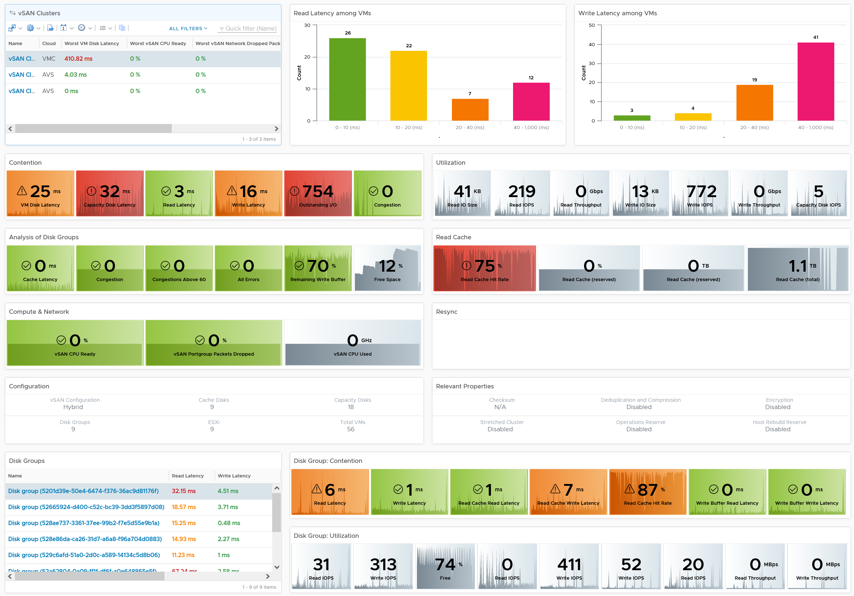
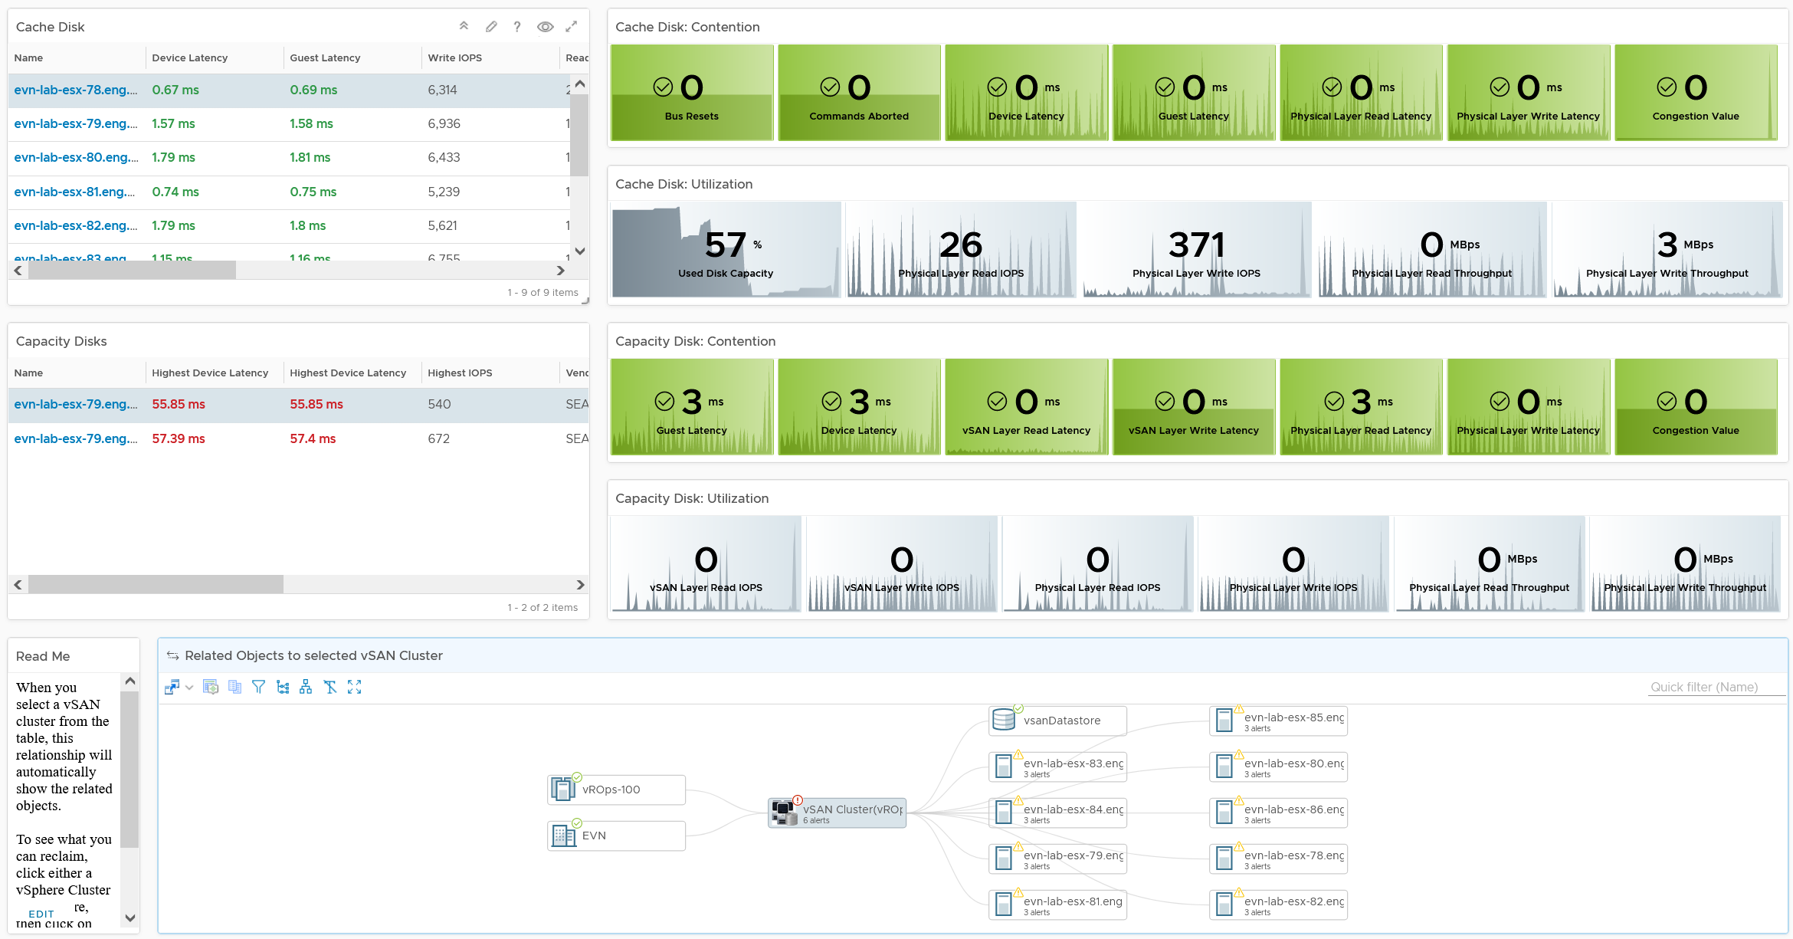
vSAN
Level: World
Performance
Level: Cluster
Consistent design
vSAN specific structure, while allowing navigation to vSphere
Level: DG
Level: Cache Disk
Level: Capacity Disk
Navigate
Notes:
Point of the slide:
Reference in the book:
Part 3 Chapter 2 Performance Dashboard: read the vSAN Performance dashboard

Slide 47

Business-driven Capacity Management
Demand
2
Control Demand by correct Pricing Model
3
Optimize Demand by Reclamation
4
Account for Latent Demand, Potential Demand and Unmet Demand
5
Monitor Demand by tracking Excessive Usage
Supply
1
Plan Supply by using Class of Service
6
Monitor using Demand|Performance + Allocation. Together
Notes:
Point of the slide: capacity has to be managed end to end
Reference in the book:
Part 1 Chapter 3 Capacity: read the “End to End Capacity” section

Slide 48
Ideal Goal
Maximize Usage, without compromising Performance
If Performance is Red Then Capacity = 0% Else Capacity = f (Utilization + Allocation)
Cluster Utilization (%)
Cluster Performance (%)
100%
100%
95%
0%
95%
HA
Overcommit >1
99 - 100
Buffer
97 - 99
99 – 100
95 - 97
97 – 99
0 – 95
95 – 97
90 – 95
0 – 80
Notes:
Point of the slide: optimal capacity management requires good performance management
Reference in the book:
Part 1 Chapter 2 Performance: read the “Performance vs Capacity” section

Slide 49
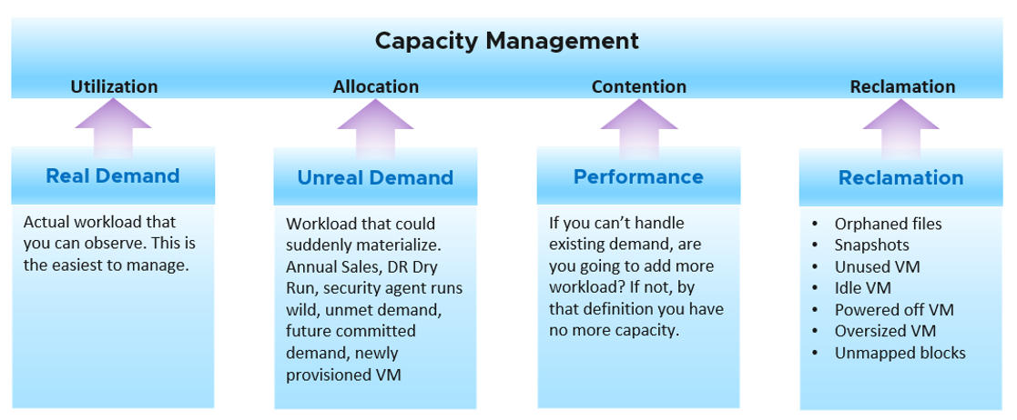
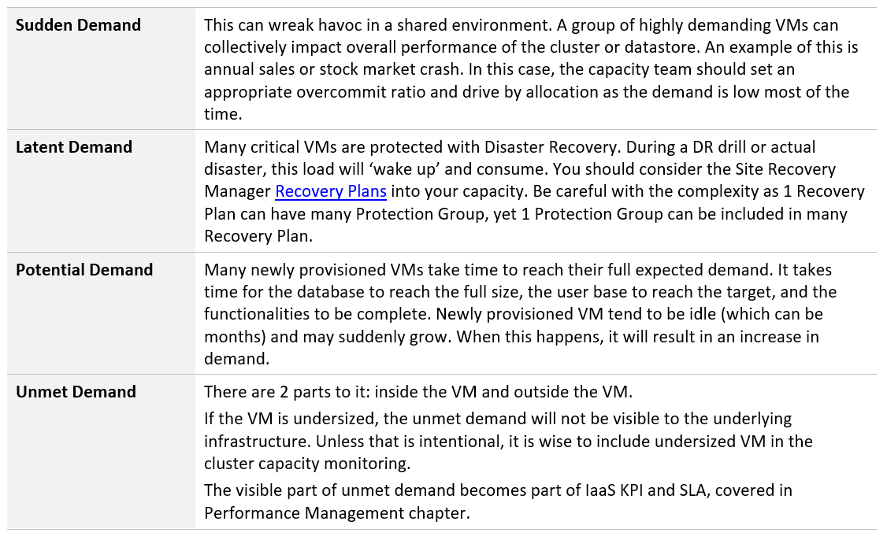
4 Inputs to Capacity
Complete coverage
Utilization
Tracking what’s visible
Allocation
Tracking what’s not visible
Contention
What you care
Reclamation
Needs to be elevated due to excessive wastage
Notes:
Point of the slide:
Reference in the book:
Part 1 Chapter 3 Capacity: read the “End to End Capacity” section

Slide 50
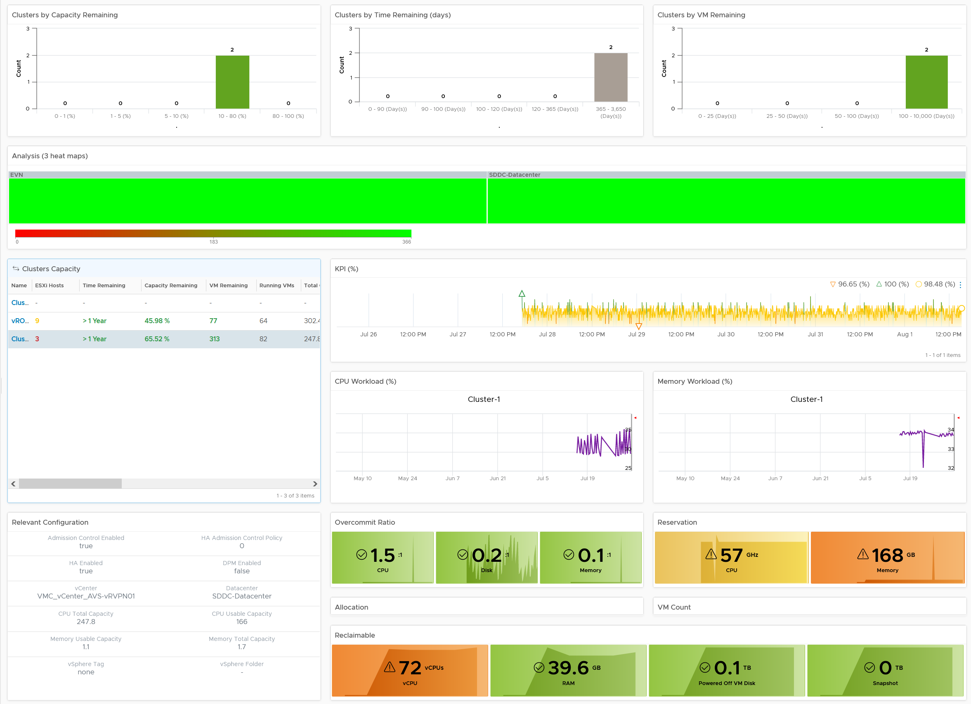
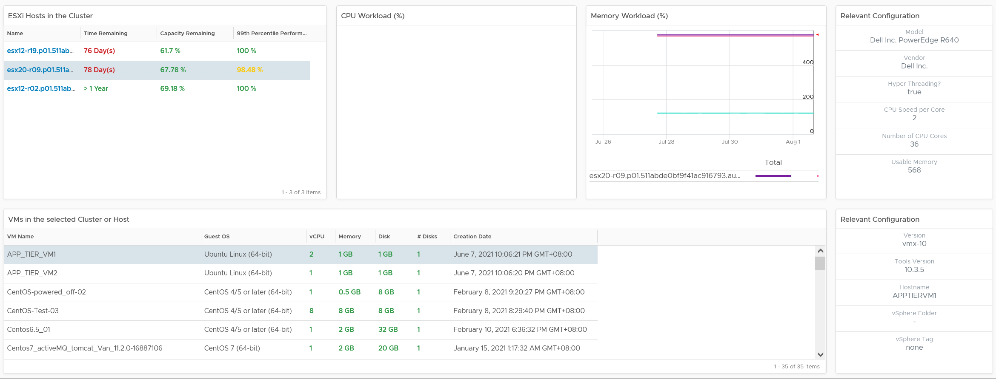
Level: World
Level: Cluster
Performance
Utilization
Allocation
Reservation
Reclamation
Level: ESXi
Level: VM
Notes:
Point of the slide: This is one way to monitor cluster capacity. How can this be improved, without adding complexity?
Reference in the book:
Part 3 Chapter 3 Capacity Dashboards

Slide 51
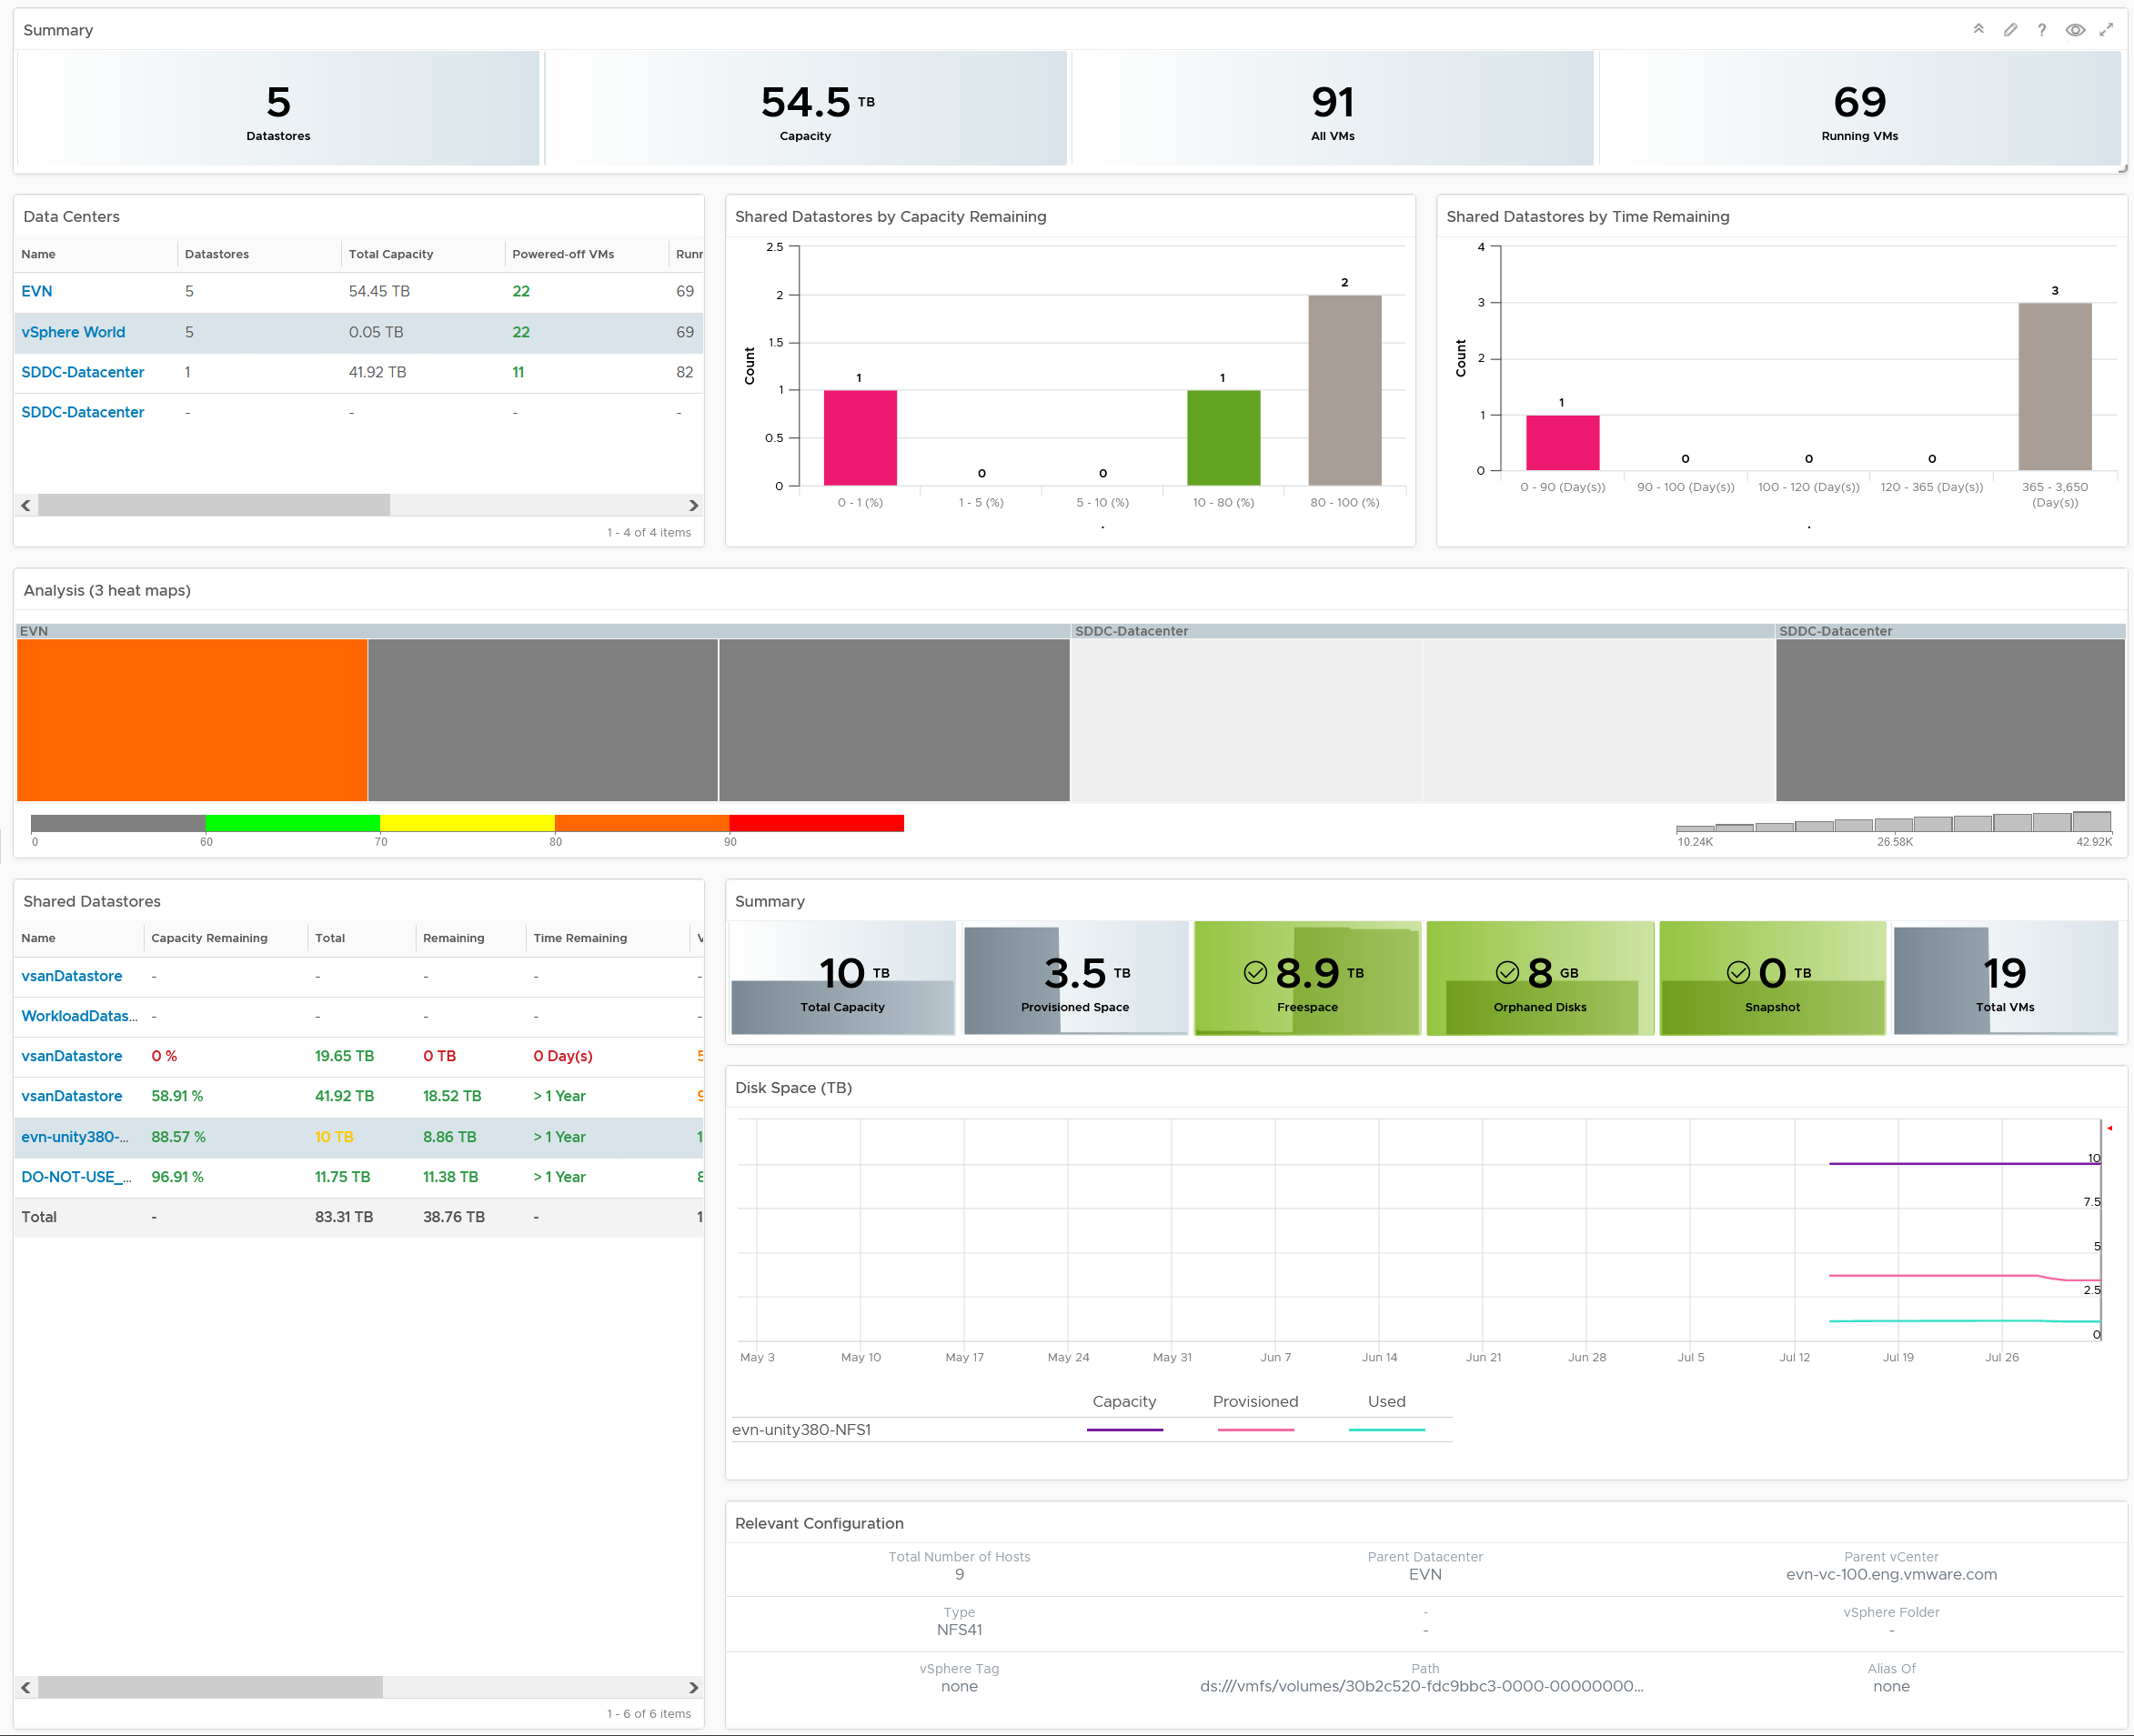
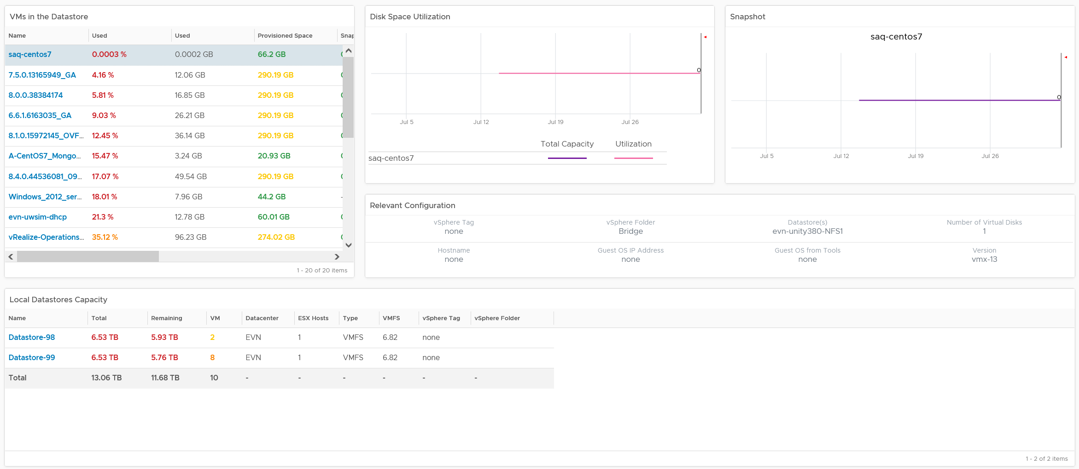
Storage
Level: World
vSAN & non vSAN
Bird-eye views
Details
With drill down to VMs
Separate dashboard for vSAN
Level: Datastore
Level: VM
Local Datastore
Notes:
Point of the slide: This is one way to monitor datastore capacity. How can this be improved, without adding complexity?
Reference in the book:
Part 3 Chapter 3 Capacity Dashboards

Slide 52
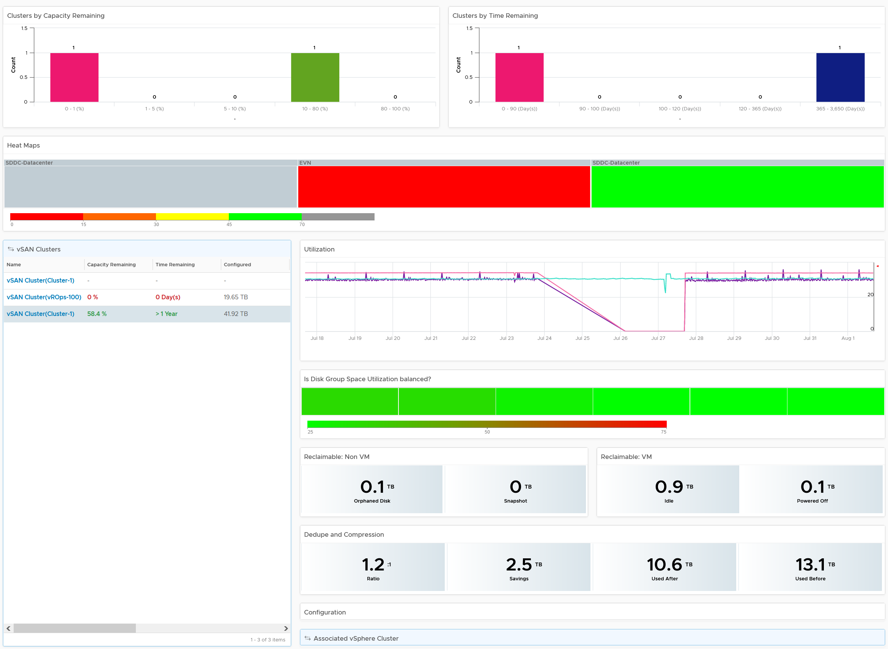
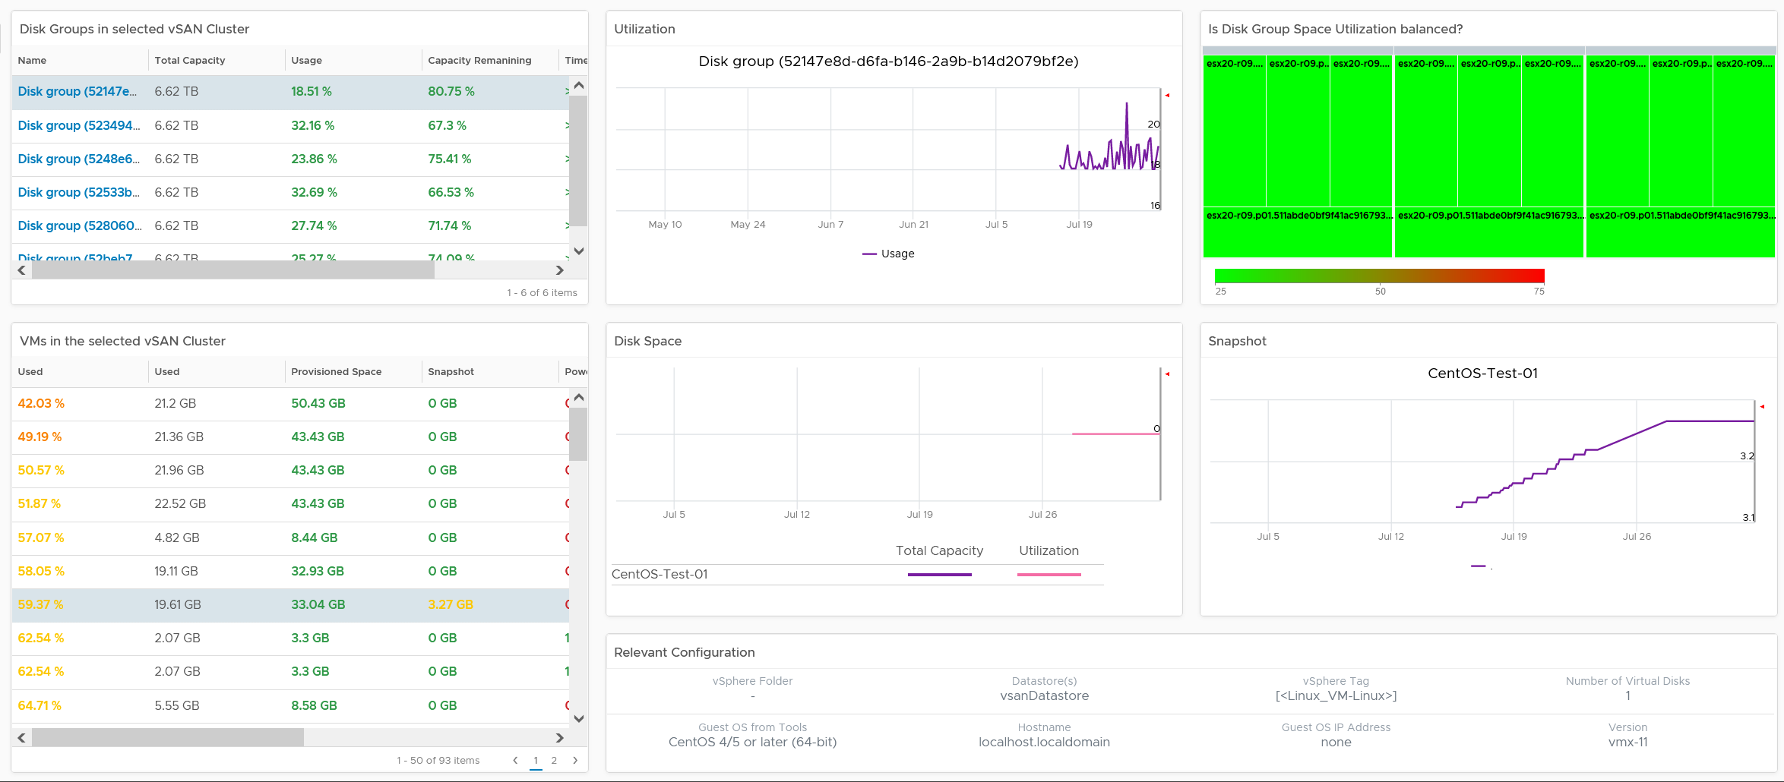
vSAN
Level: World
Deep visibility
vSAN unique structure and metrics.
Additional depth required. Drill down into each Disk Group
Level: vSAN
Level: Disk Group
Level: VM
Notes:
Point of the slide: This is one way to monitor vSAN capacity. How can this be improved, without adding complexity?
Reference in the book:
Part 3 Chapter 3 Capacity Dashboards

Slide 53
Reclamation
Start from the easiest
Non VM
Orphaned
Powered Off
Idle
Oversized
Unused?
ISO
TRIM
VMDK
RDM
LUN
Disk
LUN
Power off first
Power off first
Power off first
CPU allocation only
CPU allocation only
CPU
Memory
Memory
Memory
Notes:
Point of the slide: many areas of opportunities
Reference in the book:
Part 1 Chapter 2 Performance: read the Contention vs Utilization section

Slide 54
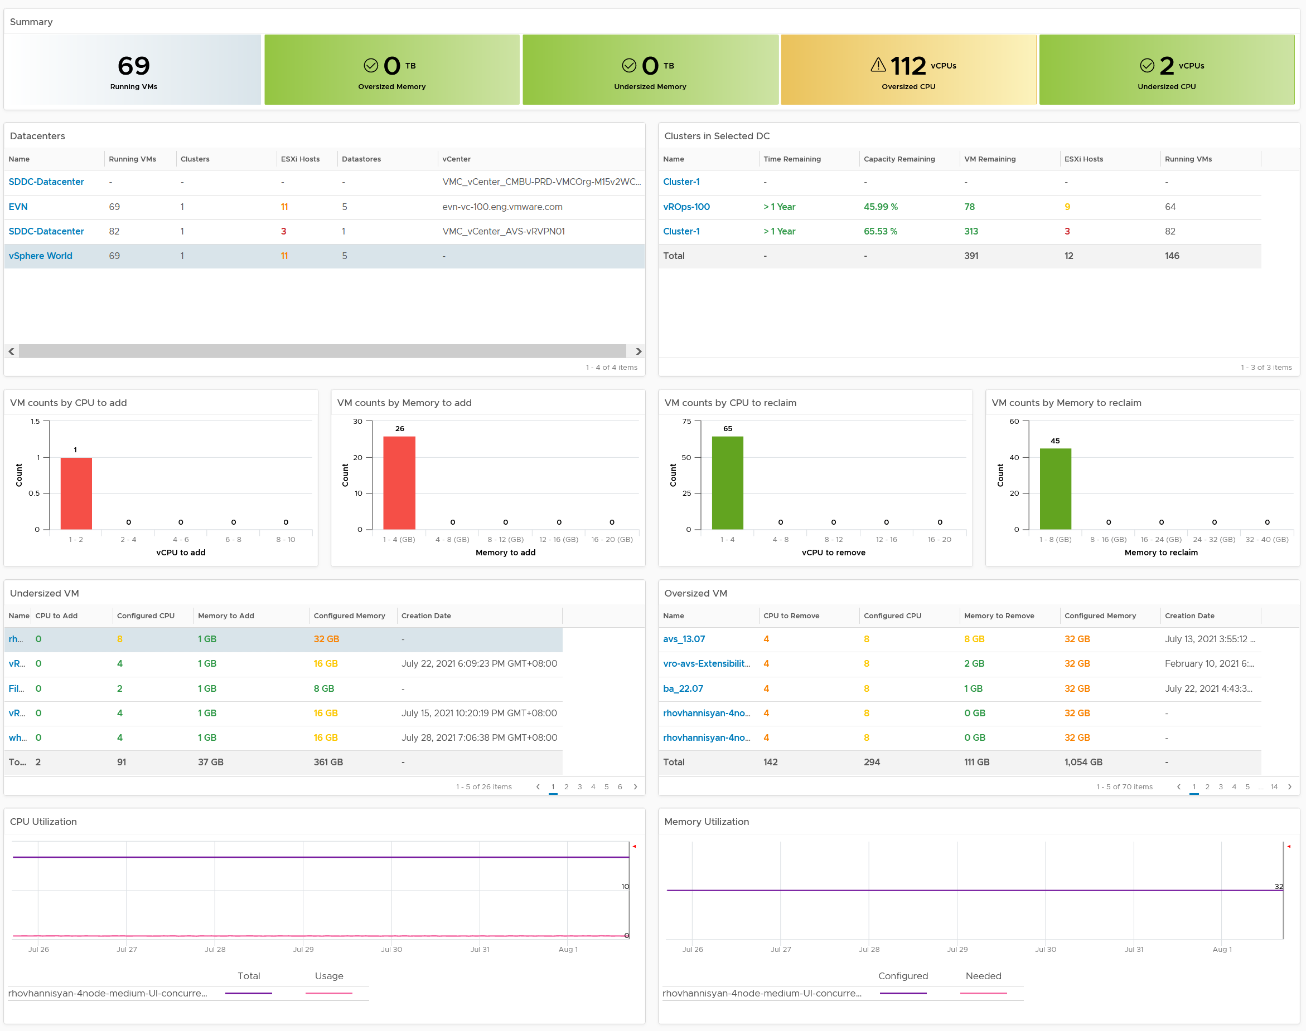
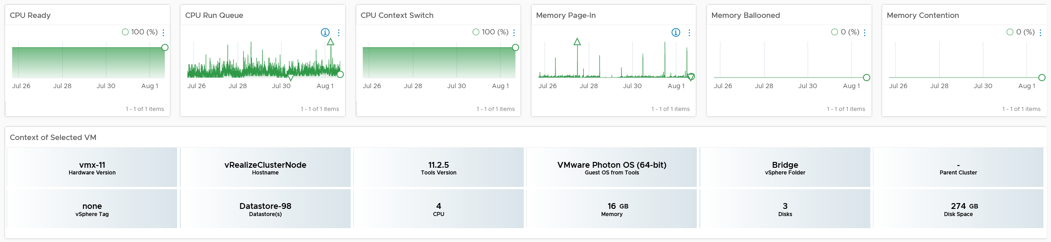
VM Rightsizing
Overall
Analysis
Selector
Analysis
Deep Analysis
Overall analysis, with drill down.
Correct usage of Guest OS metrics + VM metrics.
Important to show impact on performance. Cost is typically not the issue.
VMs
Utilization
Performance
Configuration
Notes:
Point of the slide: This is one way to monitor VM Rightsizing. How can this be improved, without adding complexity?
Reference in the book:
Part 3 Chapter 3 Capacity Dashboards

Slide 55

Dashboards for Storage Team
Basic Visibility
Performance
Availability
What have we got?
What’s the performance? How is Storage as a Service delivering?
If it’s below SLA, which VMs and ESXi are affected?
What’s our Virtual Storage Availability?
What’s our Physical Storage Availability?
Service
Capacity
Configuration
When VM Owner thinks Storage is the culprit….
Is any VM or ESXi near its peak?
Is our network near its peak?
Who are the top consumer for each physical datacenter?
How is the workload distributed?
Are the config consistent? Do they follow best practice?
Notes:
Point of the slide: you need to collaborate with storage team, to minimize ping pong. What information do they need? What do you need from them?
Reference in the book:
Part 3 Chapter 9 Other Dashboards: read the “Storage Team” section

Slide 56
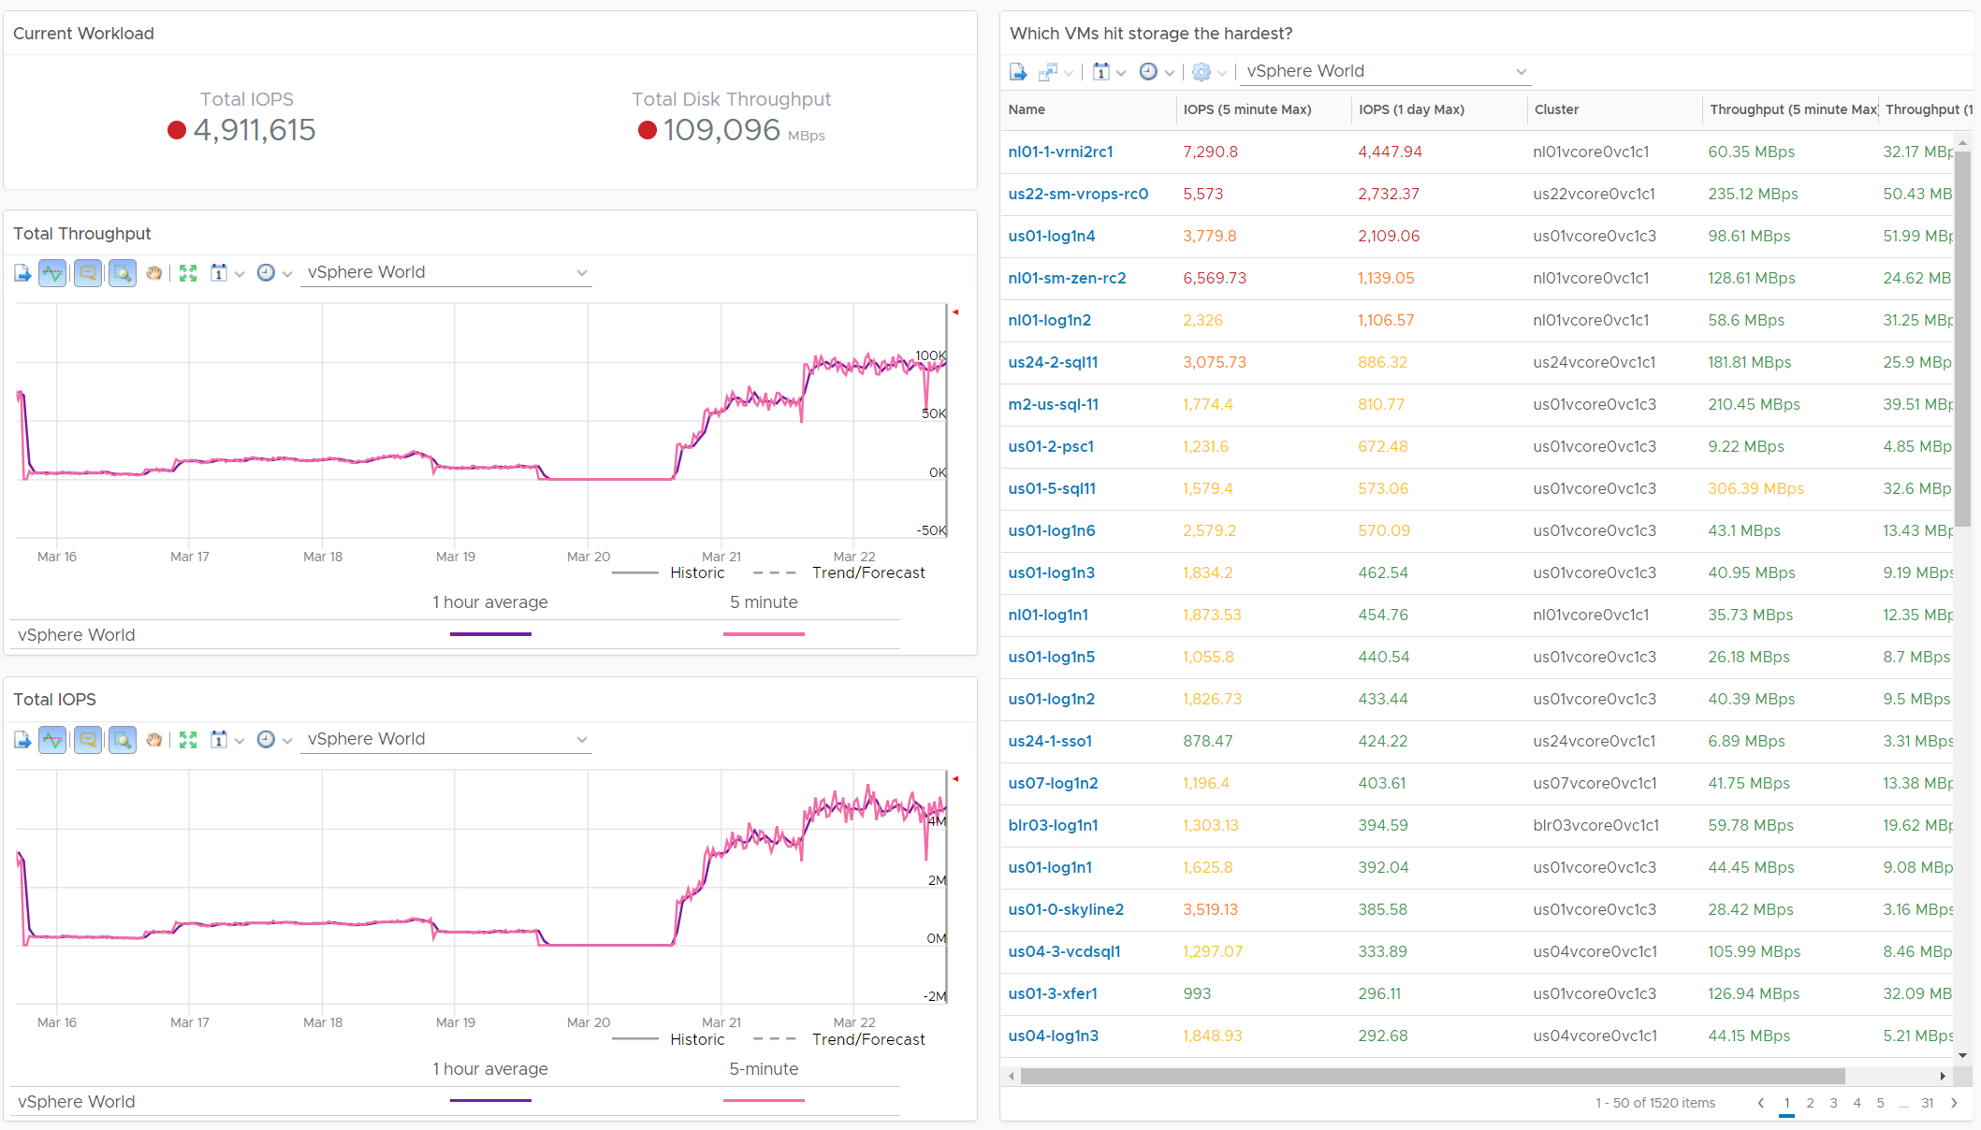
Storage Heavy Hitters
Notes:
Point of the slide: an example of dashboard. Design it with your storage team.
Reference in the book:
Part 3 Chapter 2 Performance Dashboards: see the “Heavy Hitter” dashboard.

Slide 57
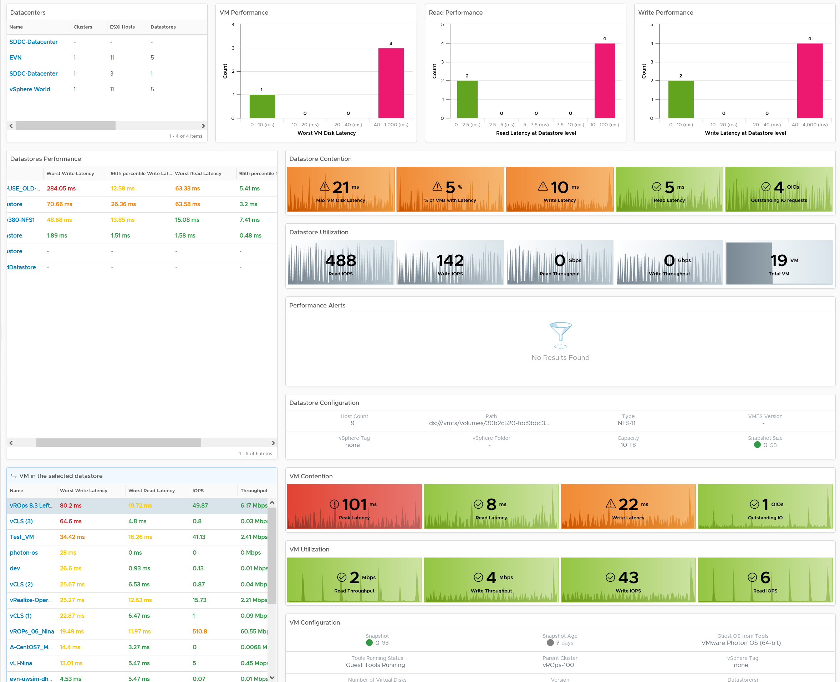
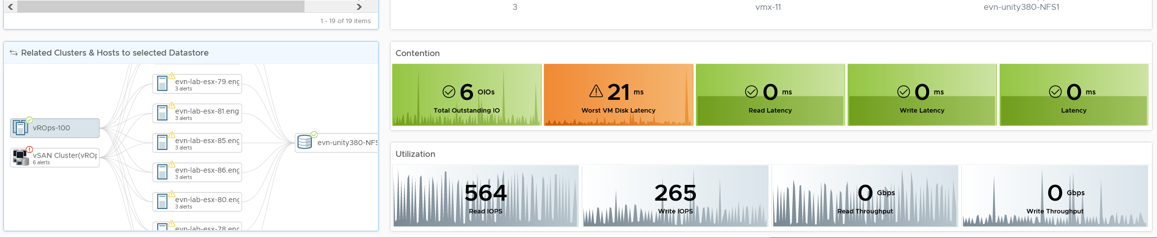
Level: World
Datastore
Performance
Level: Datastore
Performance
Utilization
Alerts
Configuration
Level: VM
Level: Related
Notes:
Point of the slide: This is one way to monitor datastore performance. How can this be improved, without adding complexity?
Reference in the book:
Part 3 Chapter 2 Performance Dashboards

Slide 58
Dashboards for Network Team
Basic Visibility
Performance
Availability
What have we got?
Any errors in our networks?
If yes, which VMs and ESXi are affected?
Too many special packets in our networks?
What’s our Virtual Network Availability?
What’s our Physical Network Availability?
Service
Capacity
Configuration
When VM Owner thinks Network is the culprit….
Is any VM or ESXi near its peak?
Is our network near its peak?
Who are the top consumer for each physical datacenter?
How is the workload distributed?
Are the config consistent? Do they follow best practice?
Notes:
Point of the slide: you need to collaborate with network team, to minimize ping pong. What information do they need? What do you need from them?
Reference in the book:
Part 3 Chapter 9 Other Dashboards: read the “Network Team” section

Slide 59
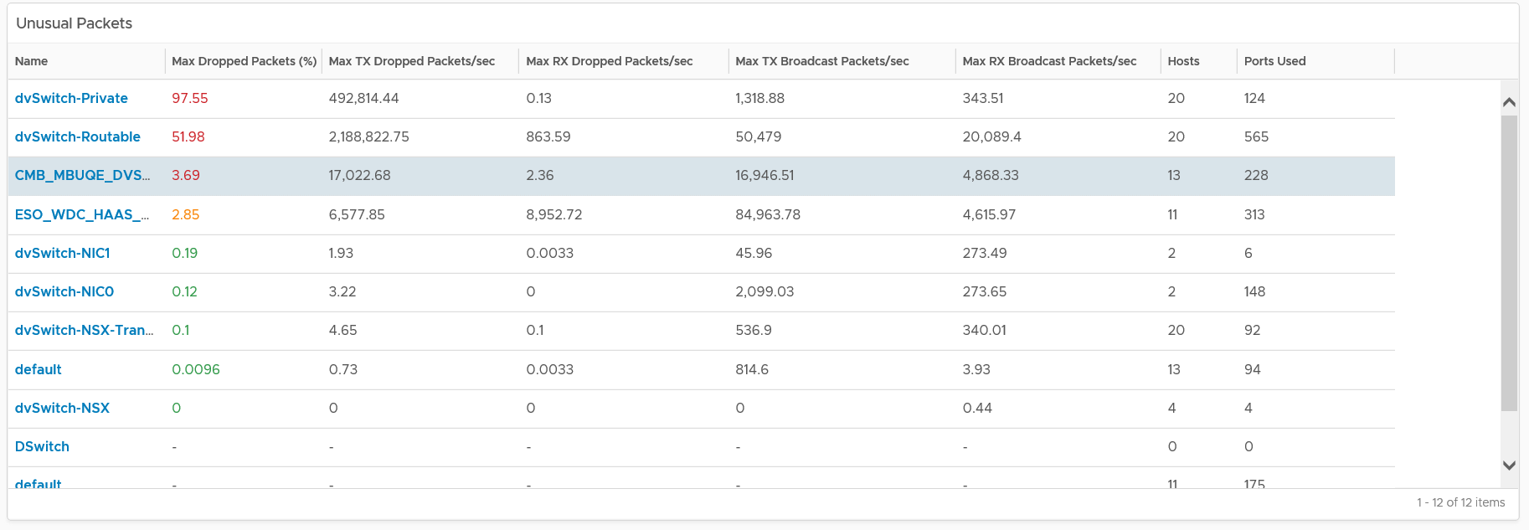
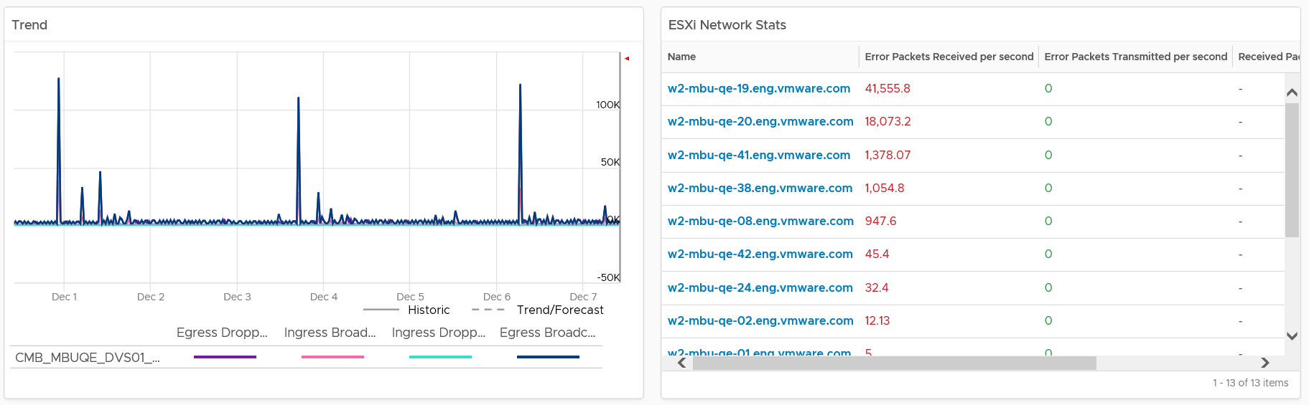
Notes:
Point of the slide: This is one way to monitor network. How can this be improved, without adding complexity?
Reference in the book:
Part 3 Chapter 9 Other Dashboards: read the :Network Team” section

Slide 60
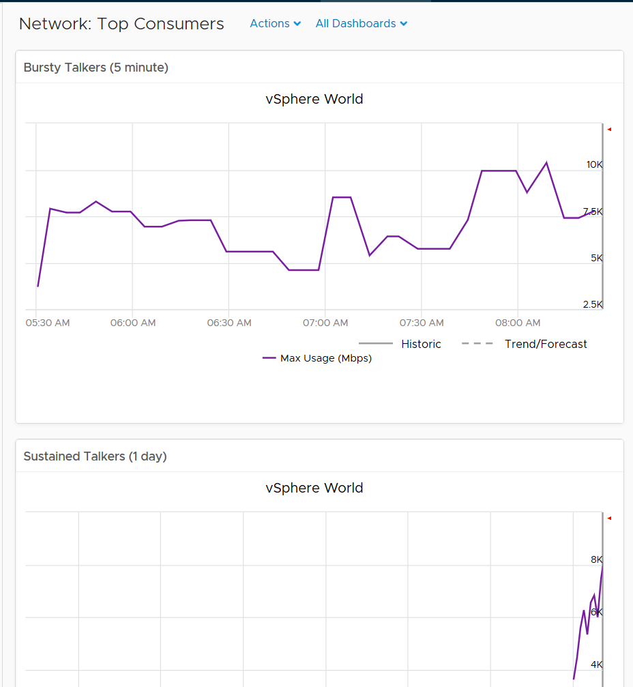
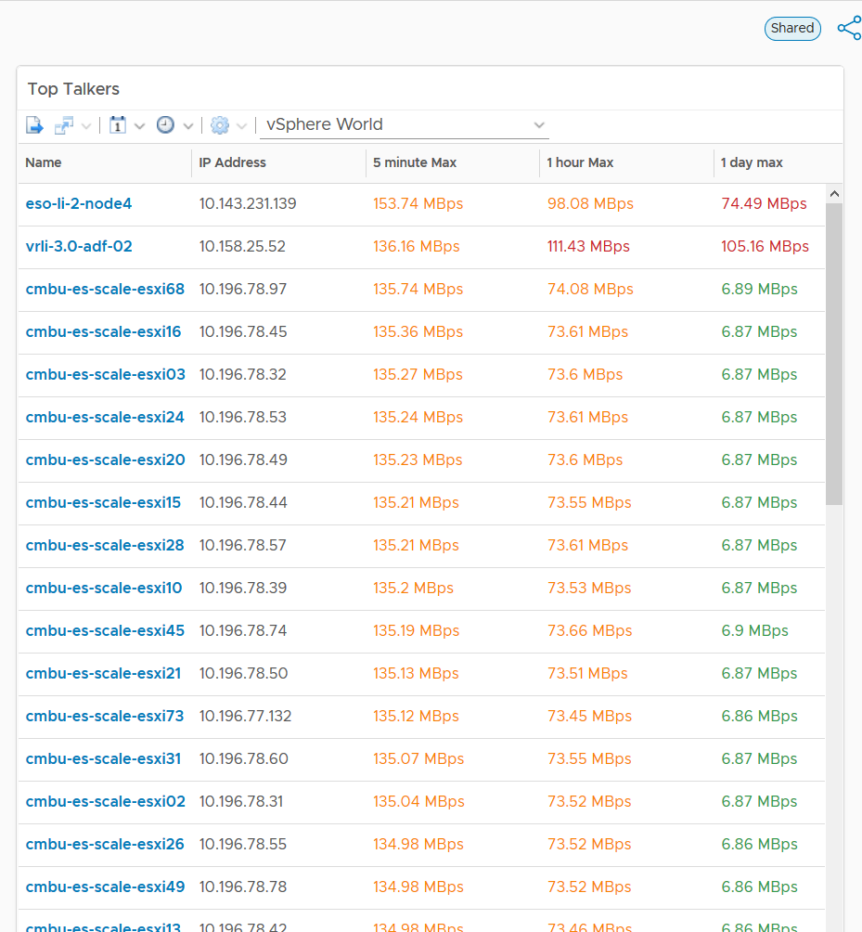
Notes:
Point of the slide: an example of dashboard. Design it with your network team.
Reference in the book:
Part 3 Chapter 2 Performance Dashboards: see the “Heavy Hitter” dashboard.

Slide 61
Executive Dashboard
Best Practices
Minimal interaction
Color
code
KISS.
Large numbers
Strategic
No jumping for nothing
5 second Test
Notes:
Point of the slide: they have their own requirements. You also need to manage them (how to leverage their strength)
Reference in the book:
Part 3 Chapter 7 Executive Dashboard

Slide 62
The Dashboards
Basic Visibility
Performance
Availability
What have we got?
What’s the VM growth?
Do we serve all the VMs well?
What’s the Critical Application Health?
What’s the VM availability
What’s our platform availability?
Capacity
Configuration
Are we wasting resources?
Are we running out of capacity? When do we need more hardware?
Are the configuration consistent? Is our environment unnecessarily complex?
Do we have outdated and unsupported products?
Notes:
Point of the slide: What information do they need? What do you need from them?
Reference in the book:
Part 3 Chapter 7 Executive Dashboard

Slide 63
NOC Dashboards
Best practices
No interaction
Color
code
KISS.
Large numbers
Drives action
5 second Test
Notes:
Point of the slide: you need to collaborate with Call Center team, so they can value add and filter. What information do they need? What do you need from them? What’s the Exit Criteria and Entry Criteria?
Reference in the book:
Part 3 Chapter 6 NOC Dashboard

Slide 64
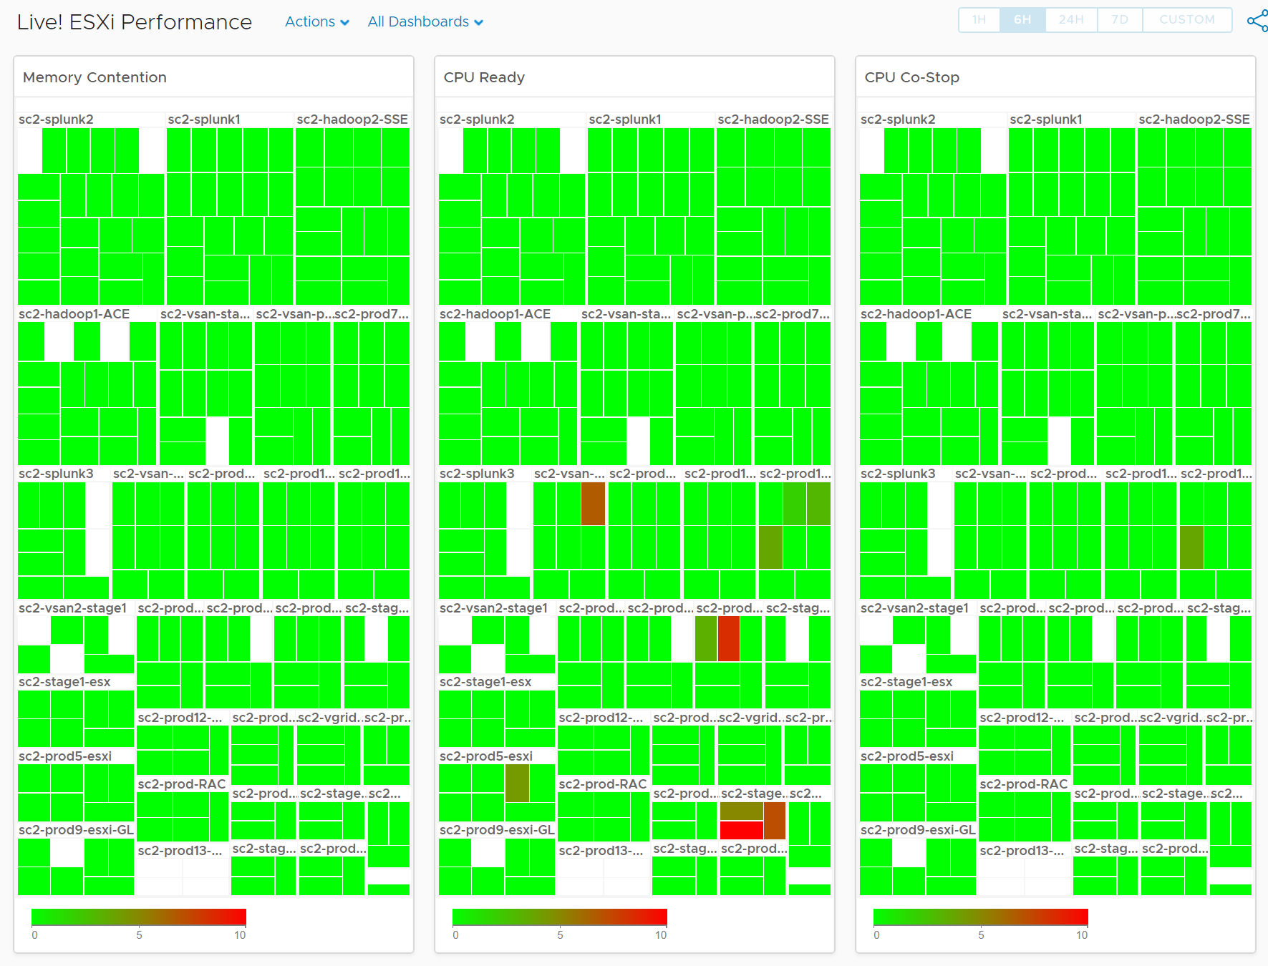
Live! Cluster Performance
VMs not getting what it asks
Are the ESXi struggling to serve its VM?
Color by Percentage of VMs not being served well. Not using Max (too extreme, focus on VM) nor Average (too late).
Percentage of VMs also enable a standard metric used for all
Size is fixed, as the focus is performance, not capacity.
Cluster unbalanced?
Showing ESXi, grouped by cluster, hence unbalanced can be seen
Expected Action
Balance the cluster
Stop provisioning
Not showing other KPI for now
Overlap, Swap Wait, IO Wait, Error Packets,
UI limitation and counter limitation
Notes:
Point of the slide: An example of design. Improve as you deem appropriate for your operations
Reference in the book:
Part 3 Chapter 6 NOC Dashboard

Slide 65
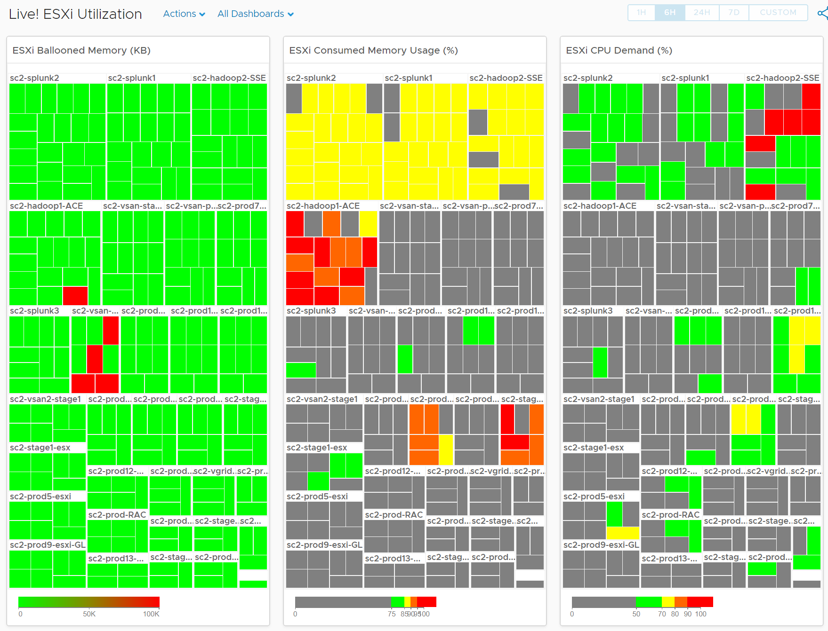
Live! Cluster Utilization
Complement Cluster Performance
2 counters for Memory
Consumed is not enough as it’s mostly cache
Balloon also persist,
Size is fixed
Else the 3 heat maps won’t be identical. Very hard to see across 3.
Notice the 3 heat maps are perfectly identical. Even the position of each group is the same!
Notes:
Point of the slide: separate utilization from contention, so the team knows what to focus.
Reference in the book:
Part 3 Chapter 6 NOC Dashboard

Slide 66
Log Analysis
Never operates SDDC & EUC without log analysis that understands the domain
No situation that the log is rotated
No uploading of logs
Speed up resolution of SR
Encourage self-service
Speed up future analysis
Notes:
Point of the slide: While 99% of logs are not required, you need have logs analysed properly.
Reference in the book:
Part 1 Chapter 2 Performance: read the Contention vs Utilization section

Slide 67
Log Analysis
Example of analysis without Log Insight
vmware.log
2016-02-01T23:42:15.266Z| vmx| I120: GuestRpcSendTimedOut: message to vdiagent timed out.
2016-02-01T23:42:15.266Z| vmx| I120: GuestRpc: app vdiagent's second ping timeout; assuming app is down
vmkernel log
2016-02-01T23:42:14.842Z cpu3:49141417)NetPort: 2916: resuming traffic on DV port 588
Analysis:
The message “resuming traffic” means VM was unavailable for a brief duration and resumed traffic transmission.
This implied that the issue occurred on the server side and not on the client side. Coinciding with the GuestRPC timedout messages, we conclude that the Guest was unresponsive during this time and resumed subsequently.
Notes:
When a vendor support tells you that a particular line of logs is the one causing the problem, what can you do?
Not much, really. The reality is log is not documented.
The only thing you can do is google it, and hopefully someone has encountered it before.
You cannot validate the logs, as there is no documentation.
But if you have proper logs, you can validate the finding. We can check each of the above error messages on VMs that are healthy. If they show the same log messages, that means the above log is not what we want.
Point of the slide:
Reference in the book:
Part 1 Chapter 2 Performance: read the Contention vs Utilization section

Slide 68
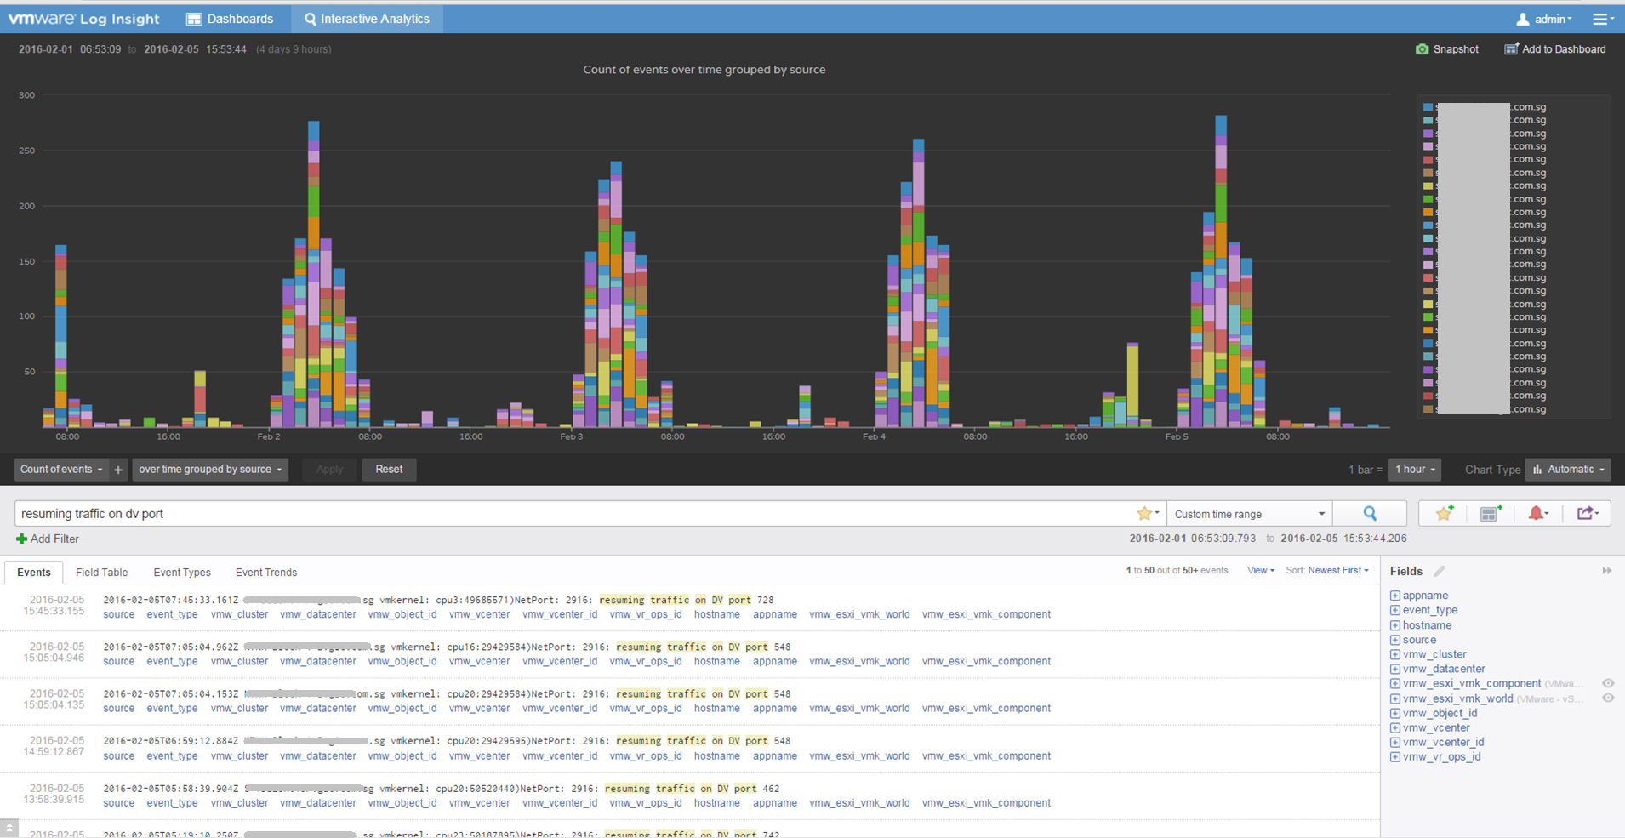
Notes:
… and that exactly what I did. I had a problem with 42 VM. I had 600 VMs in production, so majority was not affected.
Let’s see if they also see the same symptom.
I search the same string for all VMs.
Voila! It happens >1000x
“resuming traffic on DV port” probably does not mean anything. Too many of them and there is a clear pattern following office hours.
Does it mean the network has severe dropped packets?

Slide 69
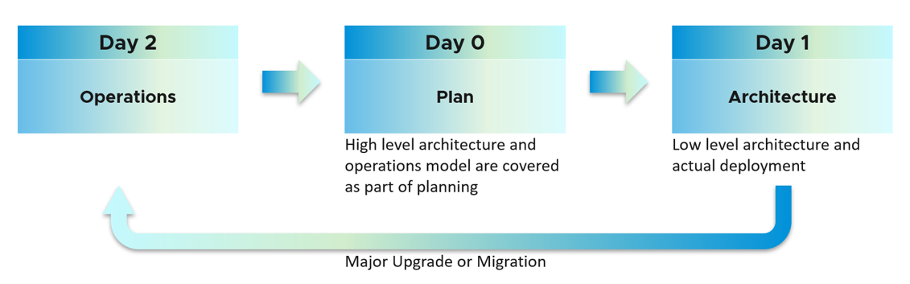
Architecting for Operations
Begin with the end in mind
How many Service Tiers does the Architecture need to have?
What do the business or customers require? What capability must each tier provide?
How to meet the requirements while keeping Operations simple and cost within budget?
Service Tier
A tier provides a certain level of Availability and Performance to every VM in the tier.
What Availability SLA and Performance SLA must it deliver?
How does it deliver the above?
What QoS does it have to ensure Tier 1 does not suffer when Tier 3 demand spike?
What is the KPI for each tier? For each cluster? For each datastore cluster?
Given a cluster or datastore, how to know what tiers it falls under?
How are applications reflected in the IaaS?
Does vCenter reflect the structure of Business Units → Department → Application → App Tier?
Given a VM, do you know which application it belongs to? In multi-tier applications, which tier does it play?
Notes:
Point of the slide: It’s 0, 1, 2. It’s 2, 0, 1.
Reference in the book:
Part 1 Chapter 1 Overview: read the Purpose-Driven Architecture section

Slide 70
Architecting SDDC for Operations
To be IaaS platform, SDDC need to be architected in a certain manner
Changes | Reason
A Cluster + Datastore need to belong to a Service Tier. | Not all clusters and storage are equal. So you need to define it.
Avoid mixing different tiers between Compute and Storage | Why does a Tier 1 VM sits on a Tier 3 storage? Mixing complicates operations. If you have 3 tiers for Compute and 3 for Storage, you have 9 combinations. How do you ensure you have enough capacity for each combination?
Do not use Resource Pool | vSphere cannot guarantee performance SLA. Tracking is also difficult.
Folder, Tag and Annotation | Reflect the business and applications
Naming convention: cluster, datastore cluster | Reflect service tiering
Use Datastore Clusters | Makes operations easier. By default, it excludes local datastores
Upgrade to latest VMware Tools | Guest OS counters
Server BIOS: set power management to OS Controlled Set ESXi Power management according to policy | Reliable performance monitoring. Some apps suffer performance at low CPU Frequency. See this.
Upgrade to latest VCF | Bug fix on counters. Audit. Tracks who makes what changes in vCenter
Notes:
Point of the slide: begin with the end in mind
Reference in the book:
Part 1 Chapter 1 Overview: read the Purpose-Driven Architecture section

Slide 71



Key Takeaways
If you don’t have SLA, you are a System Builder, not a Service Provider
Capacity is
defined by Availability & Performance
Leaving Complaint-based Operations to Proactive requires SLA
Notes:
SLA = Service Level Agreement
If you don’t have an agreement on the service level, that means you’re operating as System Builder. You may have Chargeback, you may believe you are a Service Provider, your customers say you are Service Provider. None of this matter if there is no agreement.
Monitoring Utilization is good for Capacity Planning
Monitoring Contention is IMPERATIVE for tracking the actual performance.

